Slide 1
Data Visualization and Libraries
Justin Joque
Visualization Librarian
University of Michigan
joque@umich.edu
September 2014

Slide 2
LANDSCAPE

Slide 3
A Spectrum of Research Visualization
Design
Literacy
Statistics
Graph Types
Description
Processing
Data Manipulation
Data Scraping
Exploration
Computing
Displays
3D Environment
Graphics Processing
Cluster Computing

Slide 4
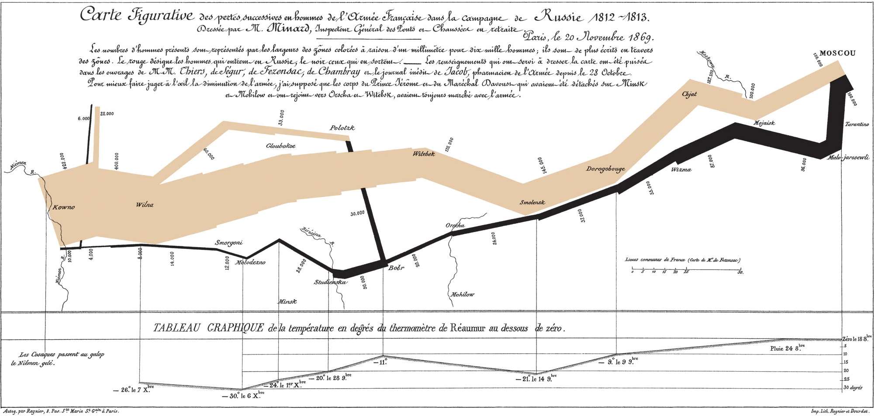
Notes:
Visualization as sense making – literacy and the world

Slide 5
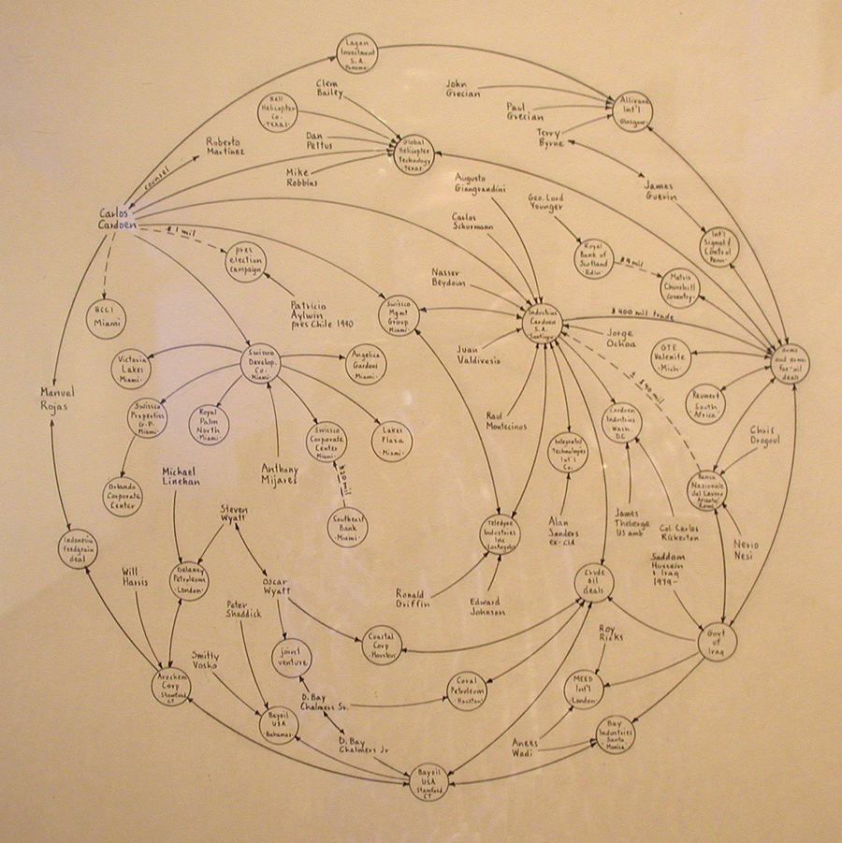
Notes:
Mark Lombardi – Sadam Hussein and global weapons trade

Slide 6
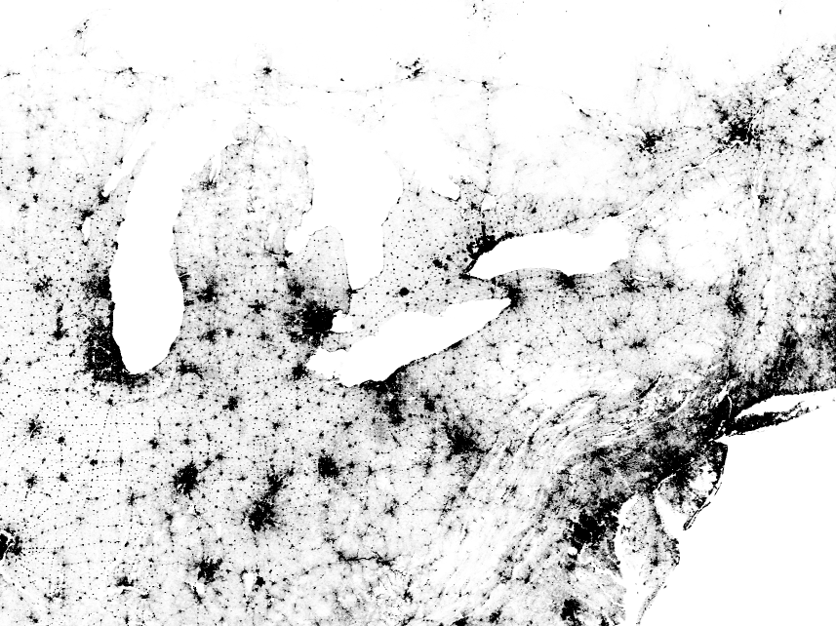
Notes:
Visualization of the Internet (The Opte Project)

Slide 7
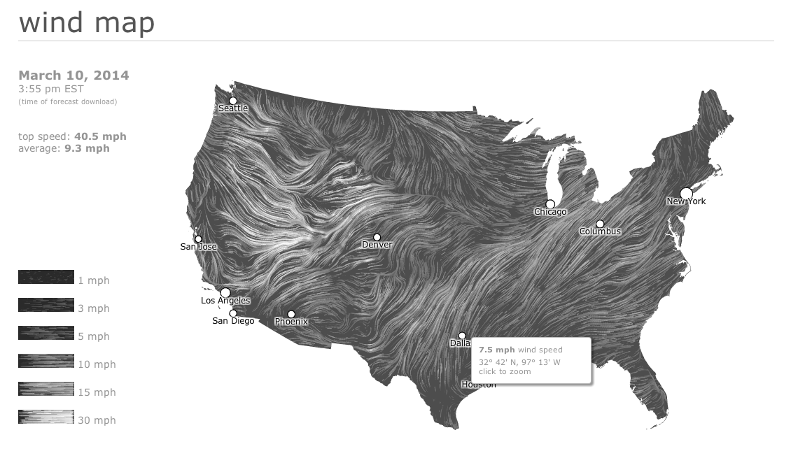

Slide 8
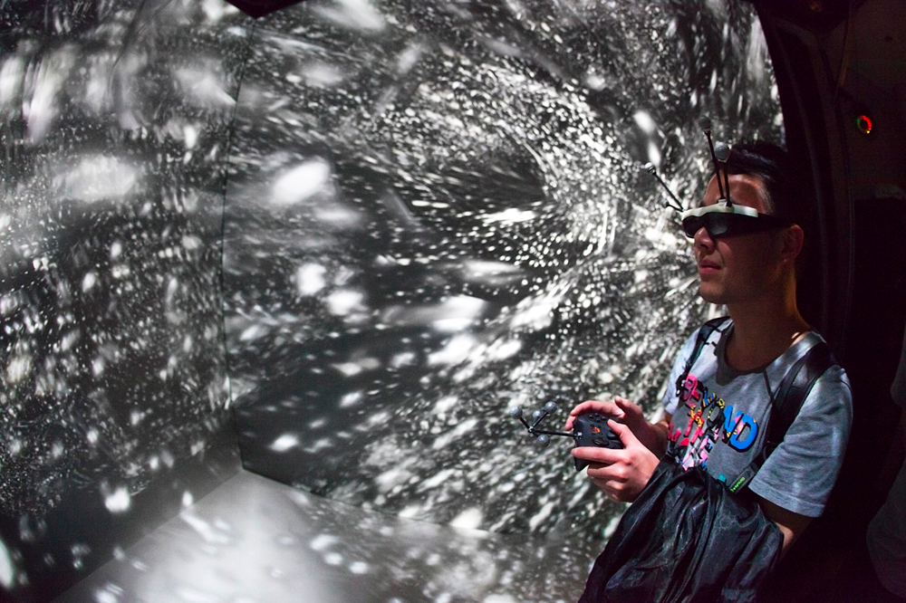
Notes:
Big data stuff

Slide 9
THE LIBRARY

Slide 10
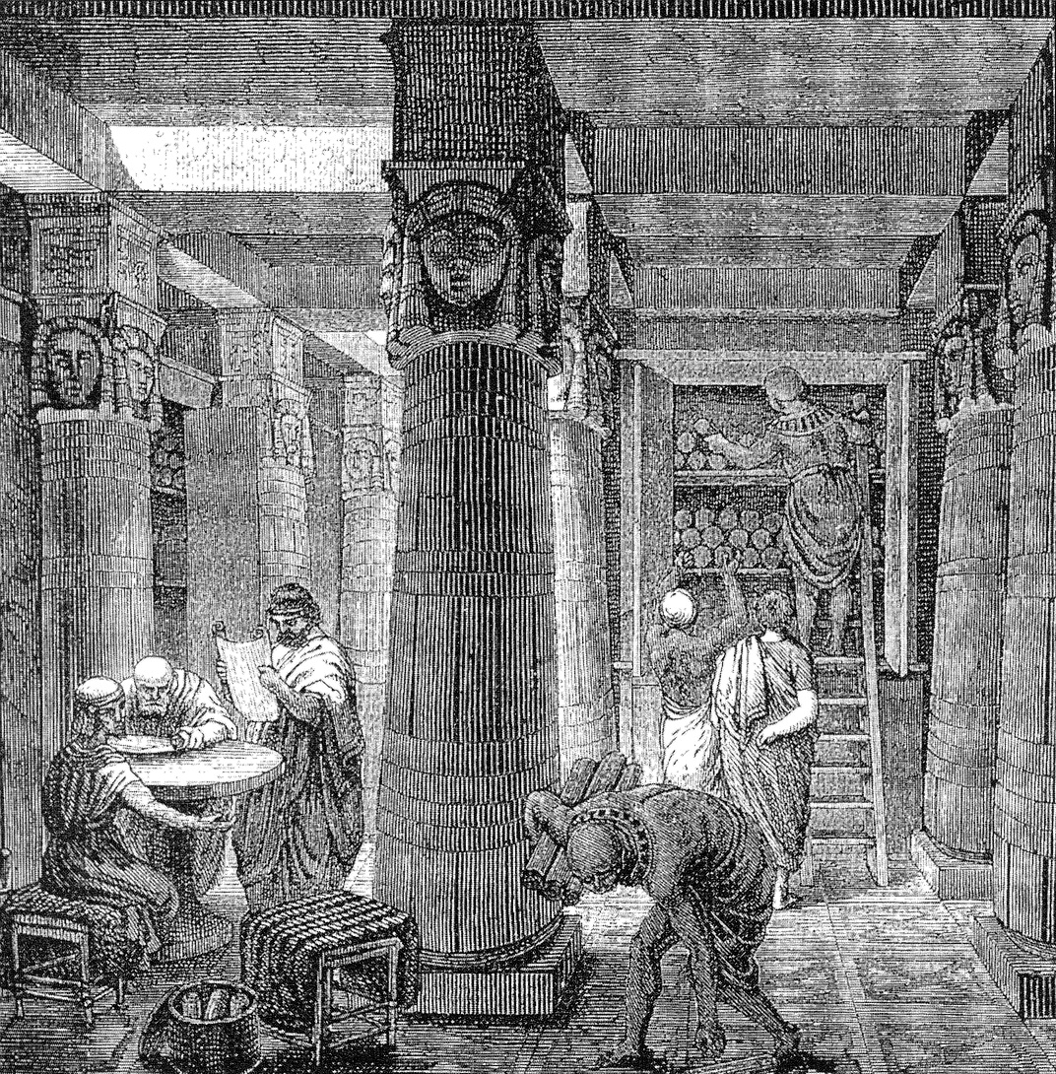

Slide 11
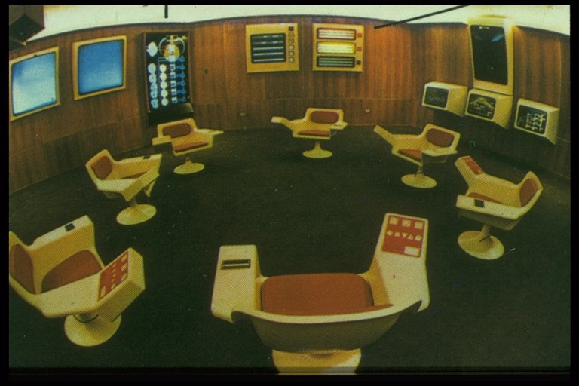

Slide 12
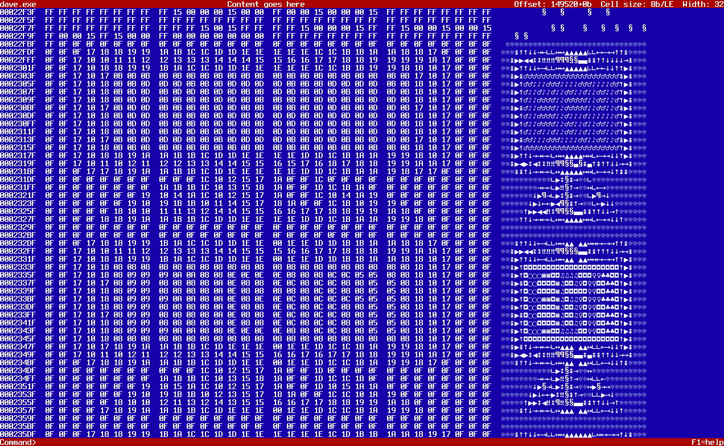
Notes:
Why the library
- Lack of interpretative framework built in

Slide 13
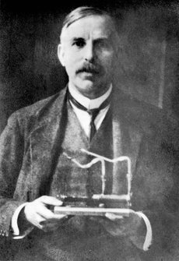
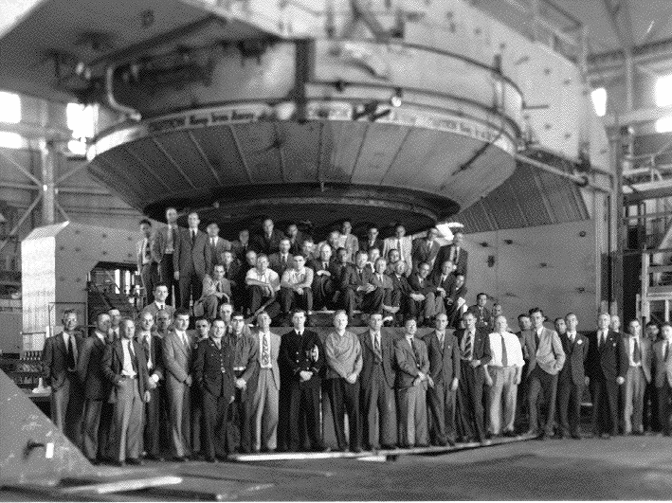
The first to disintegrate a nucleus was Rutherford, and there is a picture of him holding the apparatus in his lap. I then always remember the later picture when one of the famous cyclotrons was built at Berkeley, and all of the people were sitting in the lap of the cyclotron.
-Maurice Goldhaber, former director of Brookhaven Laboratory

Slide 14
Notes:
2nd problem:
Disciplines are bootstrapping
Requires depth rather than breadth
Alexandru Dan Corlan. Medline trend: automated yearly statistics of PubMed results for any query, 2004. Web resource at URL:http://dan.corlan.net/medline-trend.html. Accessed: 2012-02-14. (Archived by WebCite at http://www.webcitation.org/65RkD48SV)

Slide 15
Notes:
It also helps communicate across disciplines

Slide 16
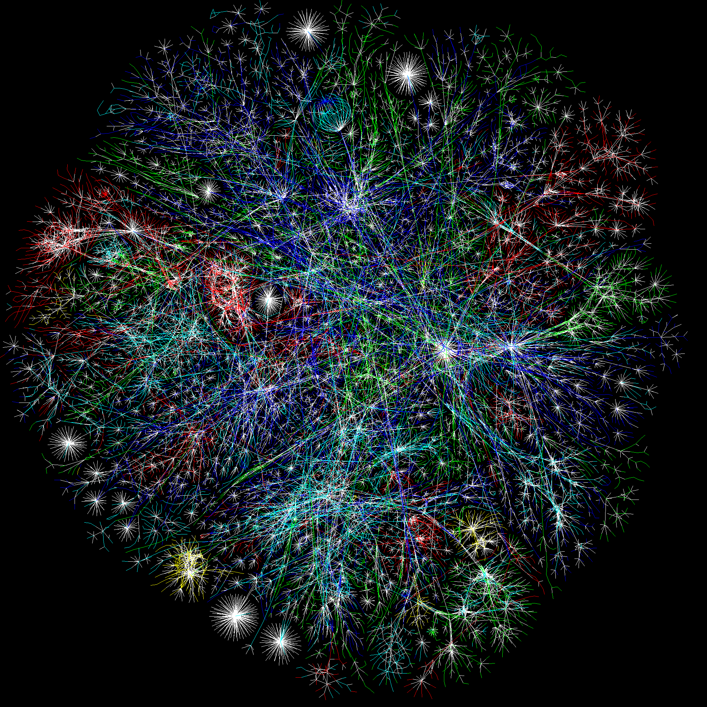
Notes:
Visualization of the Internet (The Opte Project)
2 challenges/opportunities
Context for visualization as a library service

Slide 17
PROVIDING
SERVICES

Slide 18
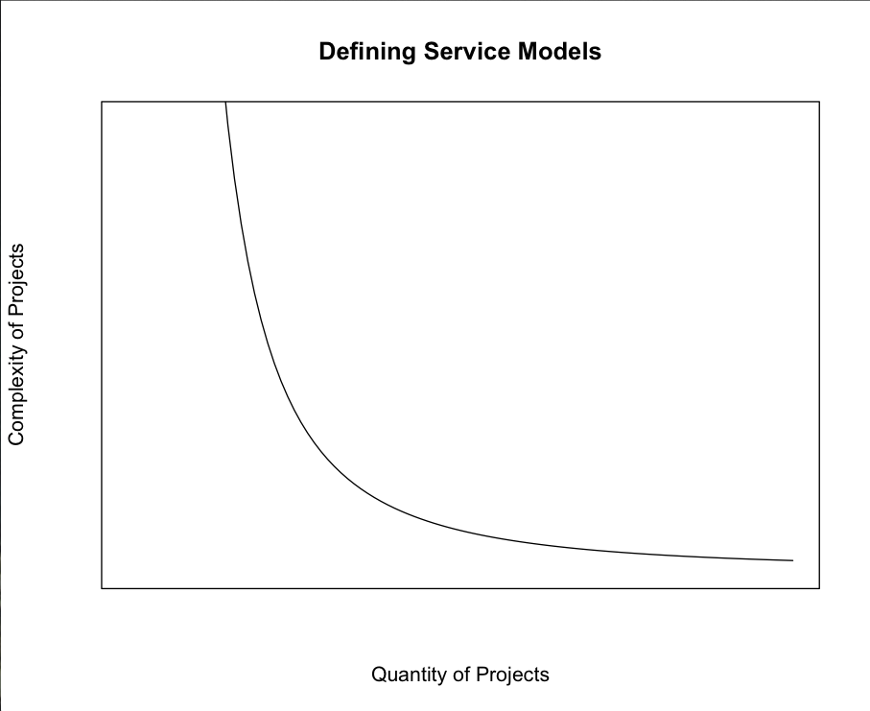

Slide 19
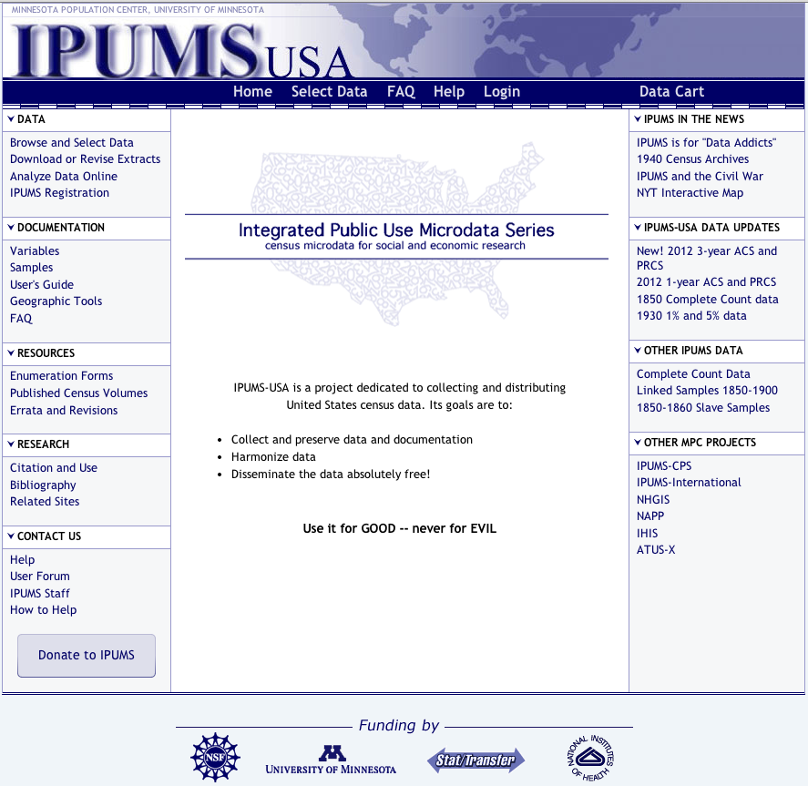
Notes:
IPUMS – not in the library

Slide 20
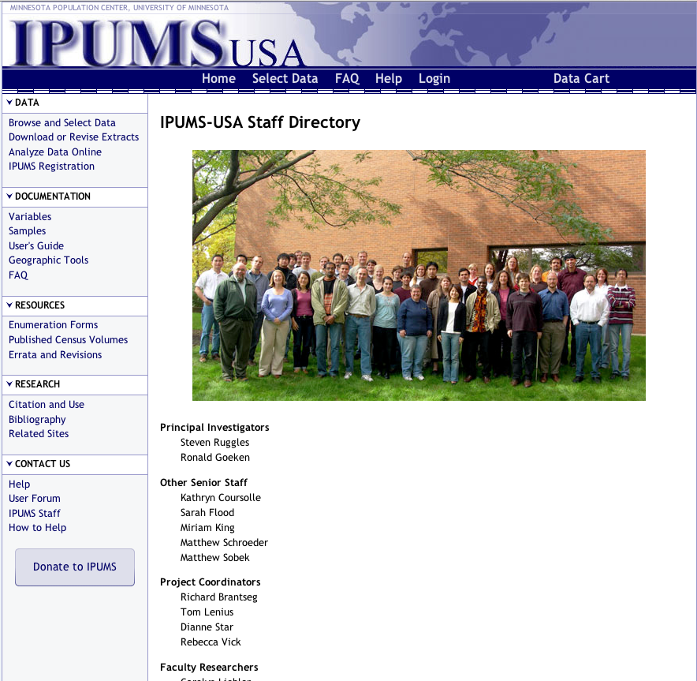

Slide 21
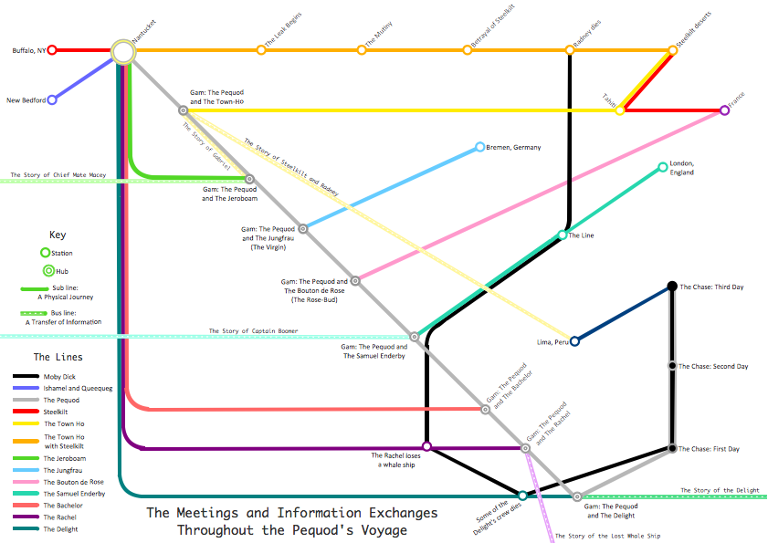
Notes:
Be involved in classes

Slide 22
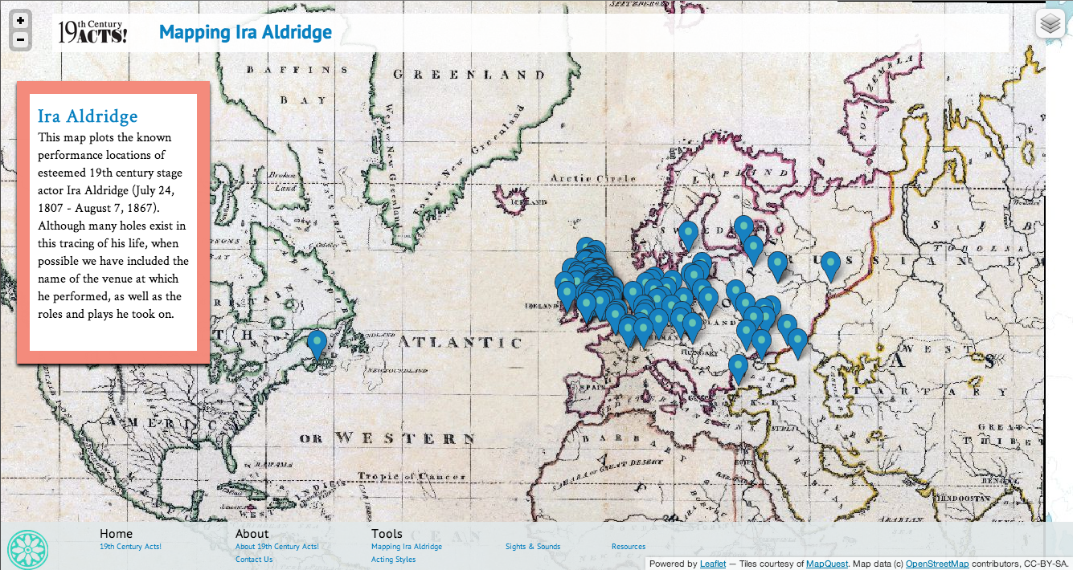
19thcenturyacts.com

Slide 23
FUTURE
CHALLENGES

Slide 24
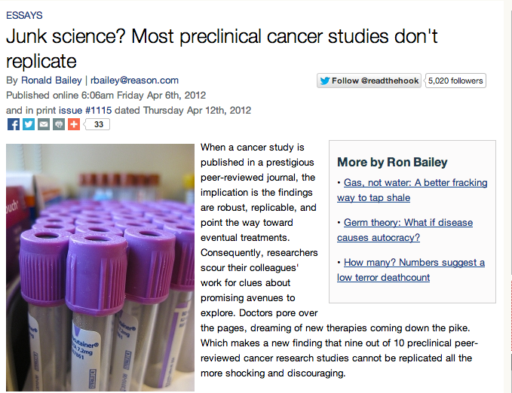
Notes:
reproducability

Slide 25
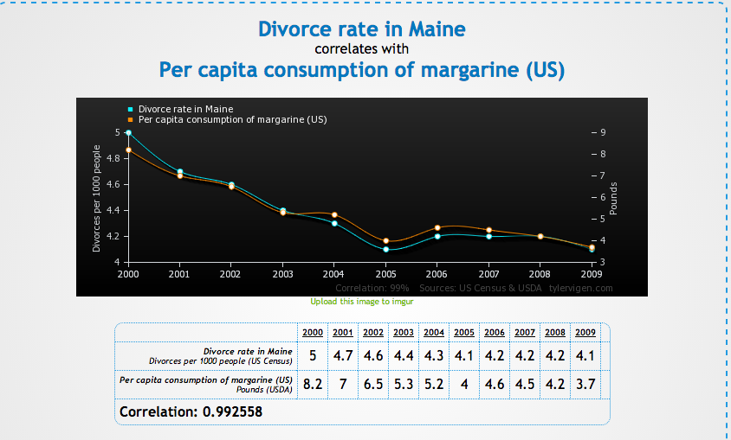

Slide 26
Thank You!
Justin Joque
Visualization Librarian
University of Michigan
joque@umich.edu

