Slide 1
Librarian involvement in systematic reviews
Mark MacEachern & Whitney Townsend

Slide 2
Broad Involvement Opportunities
Consultant
Active participant (searcher)
Teacher

Slide 3
Overview
Communicating with researchers
Teaching concepts
Searching Considerations
Reporting
Writing Methods

Slide 4
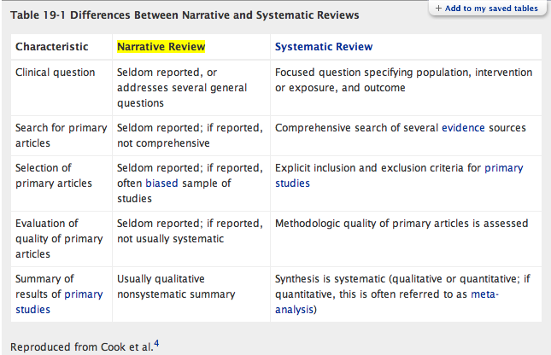
Communicating with Researchers
Notes:
How does sr differ from other searches

Slide 5
Communicating with Researchers
A high-quality lit search is essential for a successful meta-analysis
It is from the search results that data is gathered for analysis
Failure to locate important studies can significantly affect results
Remember the goal is to capture every relevant study
Important to report search so your methodology can be reproduced

Slide 6
Communicating with Researchers
Expect 1000s of results
Expect to search multiple databases
Ovid, EMBASE, Cochrane, PubMed, etc.
Expect the search process to take weeks or months
Expect to publish search strategy and search methodology
Start with set of core articles

Slide 7
Communicating with Researchers
Discuss reporting standards
PRISMA
Institute of Medicine
Cochrane Handbook
Section 6.6
What to include in abstract, methods
Full strategy
Databases searched, limits, general decisions
Flow diagrams

Slide 8
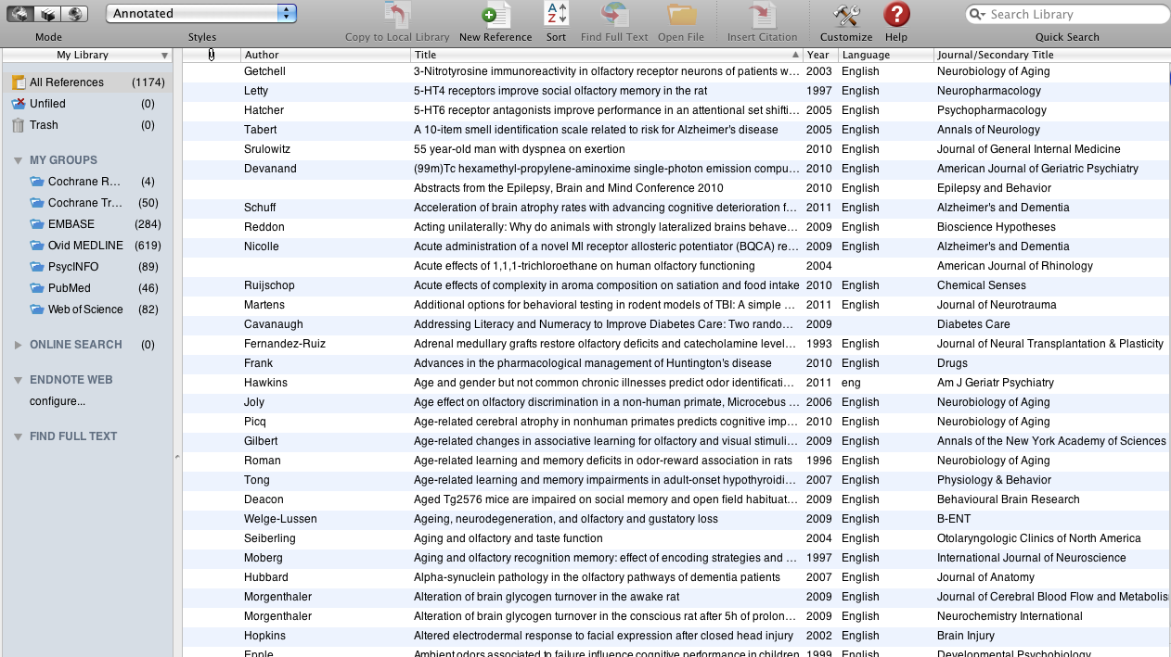
Communicating with Researchers
Endnote

Slide 9
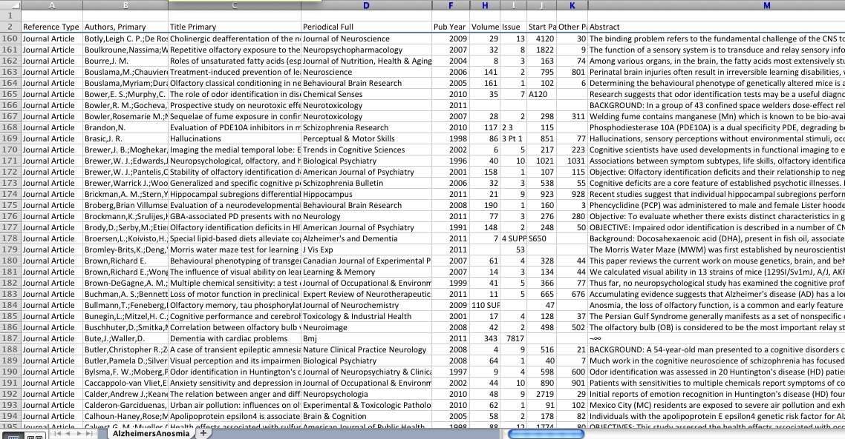
Communicating with Researchers
Excel

Slide 11
Teaching Concepts: Topic Development
Simplifying questions / topics
PICO
Identify main concepts
Harvesting search terms
MeSH, EMTREE, keyword variations, synonyms

Slide 12
Teaching Concepts: Boolean
AND
Breast Cancer
Obesity
OR
Breast Cancer
Obesity
NOT
Breast Cancer
Obesity

Slide 13
Teaching Concepts: Boolean
Concept 1
Breast cancer
Breast neoplasms
Breast tumors
Concept 2
Obesity
Obese
Overweight
BMI
Concept 3
Incidence
Epidemiology
OR
OR
OR
AND
AND
OR
OR
OR
(breast cancer OR breast neoplasms OR…) AND (obesity OR…) AND (incidence OR…)

Slide 14
Teaching Concepts: Vocabularies
Keywords
Controlled
vocabularies

Slide 15
Teaching Concepts: Vocabularies
Keywords
Controlled
vocabularies
What are they?
Literal search
Looks for occurrences of words
When to use?
Current topics
Not easy to describe concepts
No vocabulary exists in database
Examples
Drug names (Lipitor, Prozac)
Concepts (Swine flu, oil spill)
Slang / Synonyms

Slide 16
Teaching Concepts: Vocabularies
Keywords
Controlled
vocabularies
What are they?
Set of words or phrases used to describe concepts
Dictionary of accepted terms for a database
When to use?
Searching a database that uses one
Examples
MeSH (Medical Subject Headings)
EMTREE (Embase)

Slide 17
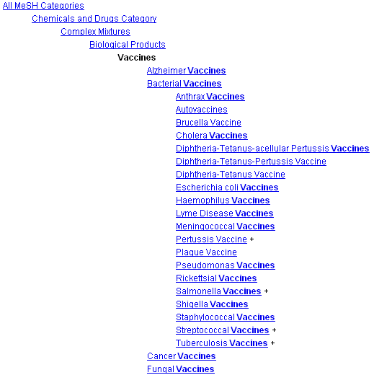
Teaching Concepts: Vocabularies
Keywords
Controlled
vocabularies
MeSH

Slide 18
Teaching Concepts: Misc
Truncation
Wild cards
Adjacency
Phrases
Explosion
Subheadings
Filters
obes*
an?sthesiology
screen* adj5 cancer*
“breast cancer”
exp breast neoplasms
surgery[subheading]
Language? Publication type?
Note: Techniques vary from database to database

Slide 19
Teaching Concepts: PubMed

Slide 21
Searching Considerations: Sources
PubMed
Ovid MEDLINE
EMBASE
Scopus
Web of Science
PsycINFO
CINAHL
Cochrane Database of Systematic Reviews
Conference Papers Index
ClinicalTrials.gov
Proquest Theses & Dissertations
CABI
Google Scholar
Sociological Abstracts
And others…

Slide 22
Searching Considerations: Sources
Examine the references of articles of relevance
Included studies and relevant reviews
Use ‘cited by’ features
Web of Science, Google Scholar
Contact authors, companies, orgs, societies, etc.
Snowballing (esp for complex questions or interventions)
Hand search important journals (by Impact Factor, perhaps)
Search for ongoing studies (prelim data)
Clinicaltrials.gov ; controlled-trials.com (ISRCTN)
Citation tracking

Slide 23
Searching Considerations: Grey literature
“Information produced on all levels of government, academic, business and industry in electronic and print formats not controlled by commercial publishing, i.e., where publishing is not the primary activity of the producing body”
Types
Conference abstracts (Conference Papers Index)
Clinical trials (ClinicalTrials.gov)
Government reports, documents (.gov, CABI)
Dissertations (ProQuest Dissertations and Theses)
Unpublished manuscripts

Slide 24
Searching Considerations: Translation
Use core articles to test searches & harvest subject headings
Ovid MEDLINE
PubMed
1. exp Arthritis, Rheumatoid/
2. exp Inflammatory Bowel Diseases/
3. cuc.tw.
4. chronic ulcerative colitis.tw.
5. crohn*.tw.
6. ibd.tw.
7. rheumatoid arthritis.tw.
8. or/1-7
9. exp Postoperative Complications/
10. exp Perioperative Care/
11. su.fs.
12. or/9-11
13. 8 and 12
("inflammatory bowel diseases"[mesh] OR "chronic ulcerative colitis” OR cuc[title/abstract] OR crohn[title/abstract] OR "crohn's” [title/abstract] OR crohns[title/abstract] OR ibd[title/abstract] OR "rheumatoid arthritis” [title/abstract]) AND ("postoperative complications"[mesh] OR "perioperative care"[mesh] OR "surgery"[Subheading] OR "post operative"[title/abstract] OR "postoperative"[title/abstract])

Slide 25
Searching Considerations: Filters
Methodological filter
A predefined search designed to target specific study methodologies (RCTs, Cohort, Systematic Reviews)
Consider using a validated filter

Slide 26
Searching Considerations: Filters
Clinical Queries
http://www.ncbi.nlm.nih.gov/books/NBK3827/#pubmedhelp.Clinical_Queries_Filters
PubMed Special Queries
http://www.nlm.nih.gov/bsd/special_queries.html
HIRU (McMaster University)
http://hiru.mcmaster.ca/hiru/HIRU_Hedges_home.aspx
SIGN
http://www.sign.ac.uk/methodology/filters.html
InterTASC
http://www.york.ac.uk/inst/crd/intertasc/
Cochrane Groups
http://www.lib.umich.edu/database/link/11791
A Comparison of 38 RCT filters
http://www.ncbi.nlm.nih.gov/pubmed/19712211

Slide 27
Searching Considerations: Evaluating Searches
Important to validate your search in each database
Make sure search captures all core articles
If search doesn’t, why?
How:

Slide 29
Reporting: IOM
Standards for Initiating a Systematic Review
Standard 2.1 Establish a team with appropriate expertise and experience to conduct the systematic review
2.1.3 Include expertise in searching for relevant evidence
Standard 2.5 Formulate the topic for the systematic review
2.5.1 Confirm the need for a new review
Standard 2.6 Develop a systematic review protocol
2.6.4 Describe the search strategy for identifying relevant evidence

Slide 30
Reporting: IOM
Standards for Finding and Assessing Individual Studies
Standard 3.1 Conduct a comprehensive systematic search for evidence
3.1.1 Work with a librarian or other information specialist trained in performing systematic reviews to plan the search strategy
3.1.2 Design the search strategy to address each key research question
3.1.3 Use an independent librarian or other information specialist to peer review the search strategy
3.1.4 – 3.1.9 Search various databases and update searches

Slide 31
Reporting: IOM
Standards for Finding and Assessing Individual Studies
Standard 3.2 Take action to address potentially biased reporting of research results
3.2.1 Search grey literature databases, clinical trial registries, and other sources of unpublished information about studies
3.2.4 – 3.2.6 Handsearch, web search, and non-English search
Standard 3.4 Document the search
3.4.1 Provide a line-by-line description of the search strategy

Slide 32
Reporting: Cochrane Handbook
See Cochrane Handbook
http://www.cochrane-handbook.org/
Section 6.6
“It should be borne in mind at the outset that the full search strategies for each database will need to be included in an Appendix of the review.”

Slide 33
Reporting: Cochrane Handbook
See Cochrane Handbook
http://www.cochrane-handbook.org/
Section 6.6
In study flow diagram:
number of unique records identified by the searches;
number of records excluded after preliminary screening (e.g. of titles and abstracts); and
number of records retrieved in full text

Slide 34
Reporting: Cochrane Handbook
See Cochrane Handbook
http://www.cochrane-handbook.org/
Section 6.6
In abstract:
List all databases searched.
Note the dates of the last search for each database or the period searched.
Note any language or publication status restrictions (but refer to Section 6.4.9).
List individuals or organizations contacted.

Slide 35
Reporting: Cochrane Handbook
See Cochrane Handbook
http://www.cochrane-handbook.org/
Section 6.6
In methods:
List all databases searched.
Note the dates of the last search for each database AND the period searched.
Note any language or publication status restrictions
List grey literature sources.
List individuals or organizations contacted.
List any journals and conference proceedings specifically handsearched for the review.
List any other sources searched (e.g. reference lists, the internet).

Slide 36
Reporting: PRISMA
See PRISMA statement
“The aim of the PRISMA Statement is to help authors report a wide array of systematic reviews to assess the benefits and harms of a health care intervention. PRISMA focuses on ways in which authors can ensure the transparent and complete reporting of systematic reviews and meta-analyses.”
http://www.prisma-statement.org/statement.htm

Slide 38
The Systematic Literature Search
Reporting Standards, Methodology, Co-authorship, and Librarian Involvement

Slide 39
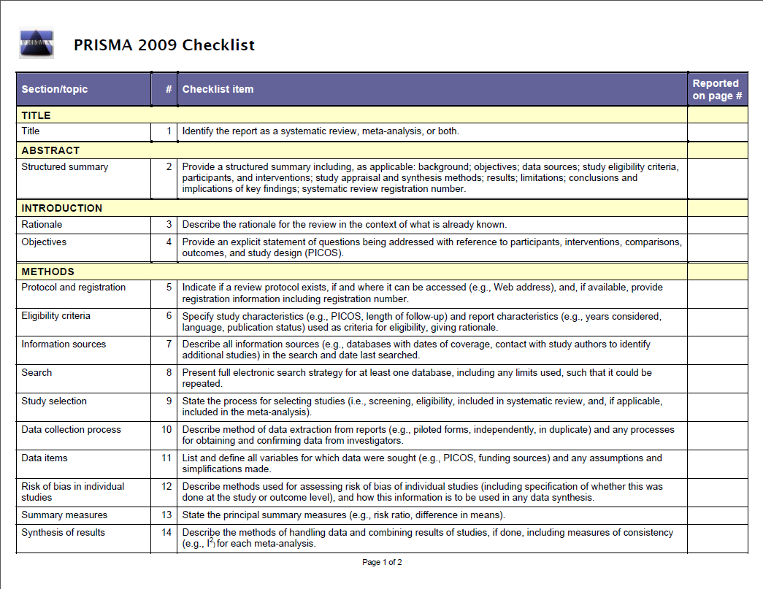

Slide 40
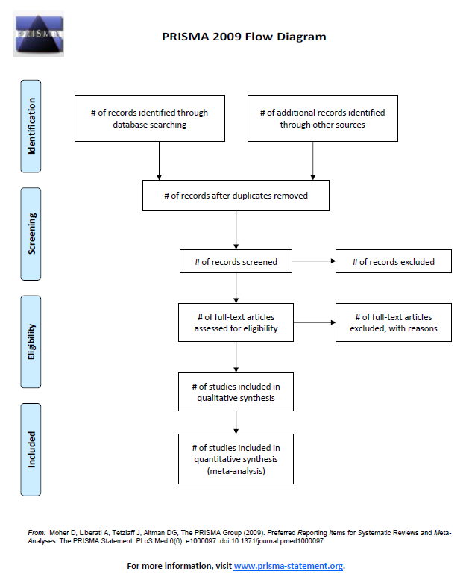

Slide 41
Literature Search Reporting Appraisal
Teams of 5
Review literature search methodology/reporting
Report out to the group
Your appraisal
What you would change/improve

Slide 42
PRISMA Reporting Standards

Slide 43
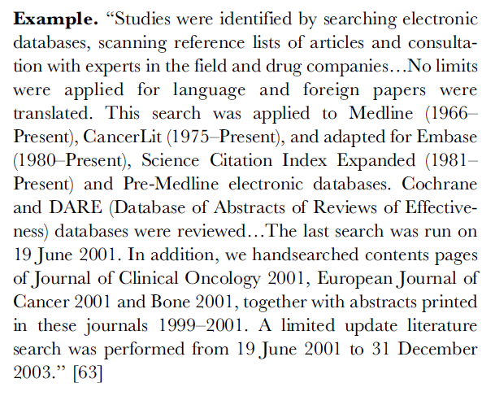
Item 7: Example

Slide 44
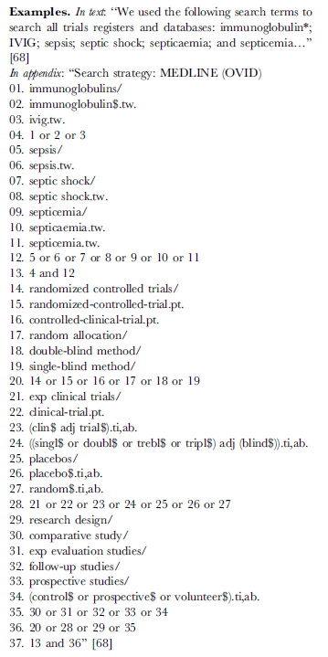
Item 8: Example

Slide 45
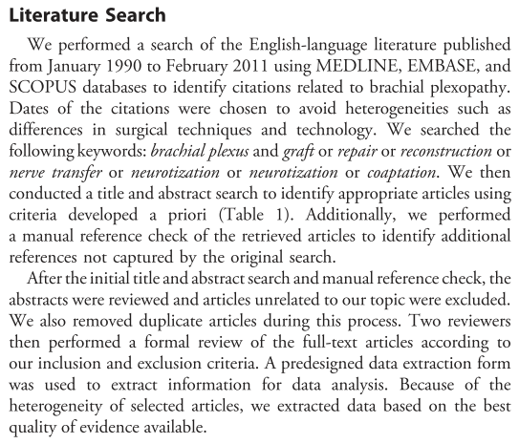
Article #1: Yang et al

Slide 46
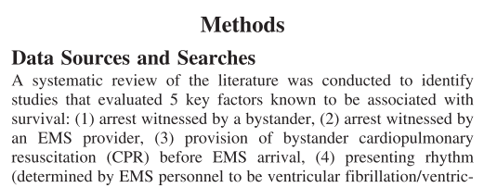
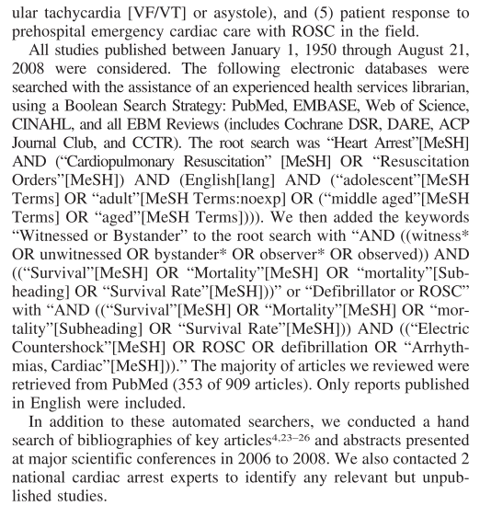
Article #7: Circ Cardiovasc Qual Outcomes

Slide 47
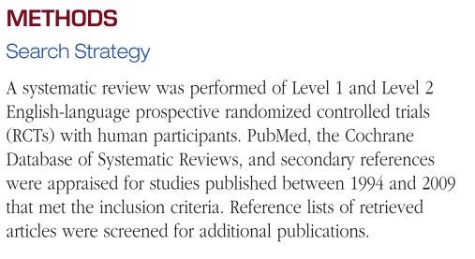
Article #8: Sports Health

Slide 48
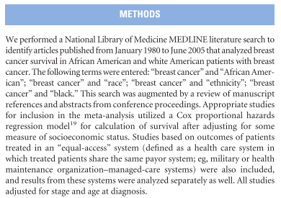
Article #2: Breast Cancer Survival & Ethnicity

Slide 49
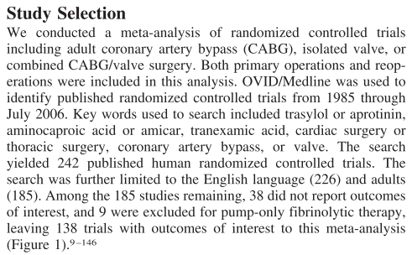
Article #3: Circulation June 5, 2007

Slide 50
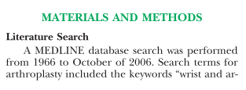
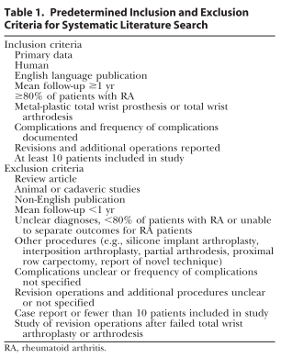
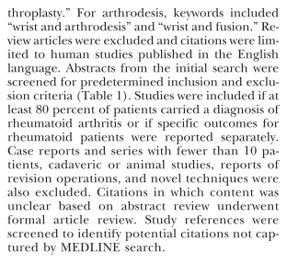
Article #4: Management of Rheumatoid Wrist

Slide 51
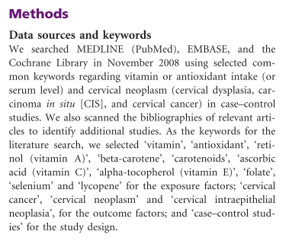
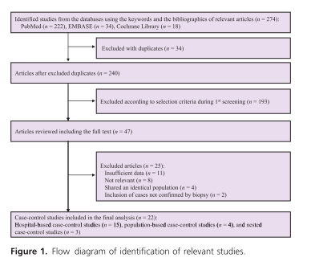
Article #5: Myung et al

Slide 52
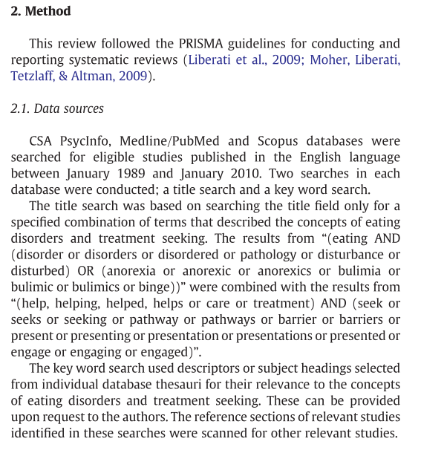
Article #6: L.M. Hart et al

Slide 53
Why have a librarian involved?
Justifying your existence
and inclusion in the systematic review process

Slide 54
The Short Answer
We’ll increase the methodologic quality of your systematic review

Slide 55
Librarian involvement in locally-created systematic reviews
Whitney Townsend
University of Michigan

Slide 56
Librarian involvement in locally-created systematic reviews
Overview
Methodology
Results
Discussion

Slide 57
Overview
The Institute of Medicine and the Agency for Healthcare Research and Quality both recommend utilizing a health sciences librarian for the literature search component when conducting systematic reviews.
Despite this recommendation, it is hypothesized that few non-Cochrane systematic review teams include a librarian in the development of their literature search strategies.
The Team
Whitney Townsend (lead)
Andy Hickner
Mark MacEachern
Nandita Mani
Irina Zeylikovich

Slide 58
Methodology: Search
Database: Scopus
Date range: 1/1/2003 – 12/31/2012
Search strategy:
((TITLE("systematic review" OR "meta-analysis" OR "meta analysis")) OR (INDEXTERMS("systematic review" OR "meta analysis" OR "meta-analysis as topic"))) AND ( EXCLUDE(DOCTYPE,"le" ) OR EXCLUDE(DOCTYPE,"ed" ) OR EXCLUDE(DOCTYPE,"sh" ) OR EXCLUDE(DOCTYPE,"no" ) ) AND ( EXCLUDE(DOCTYPE,"cp" ) )
AND
All applicable affiliations (AF-ID field) related to the University of Michigan (Ann Arbor) (full details available upon request from the poster authors)
Results: 638 citations; 368 met systematic review criteria (61%) after review
Review process: A team of five librarians divided the 638 citations among themselves, and reviewed the full text article for each citation. Study inclusion and coding was based on a predetermined criteria.

Slide 59
Methodology: Inclusion/Exclusion
Systematic Review - Clearly “attempts to identify, appraise and synthesize all the empirical evidence that meets pre-specified eligibility criteria to answer a given research question.” Paper authors used explicit methods by conducting a structured literature search, identifying relevant studies, and analyzing the results of the studies. (Section 1.2 in the Cochrane Handbook for Systematic Reviews of Interventions.)
Librarian Involvement - Full papers were reviewed to identify librarian involvement (no librarian involvement, unnamed acknowledgement, named acknowledgement, co-author)
Replicable Search – Defined as a search strategy (included in the paper, or available as a supplement or from the authors) that can be easily replicated or copy-pasted into the appropriate indicated database with identical or near-identical results
Search Limits – Authors indicated the use of traditional search limits (ex. English, human, date range)
Databases Cited – Databases searched as written by the author (ex. PubMed, Medline, Ovid are not differentiated)

Slide 60
Results
Institutional Systematic Review Publishing
386 total systematic reviews published by University of Michigan affiliated authors
47 total systematic reviews indicated some level of librarian involvement (co-authorship or acknowledgement)

Slide 61
Results
Institutional Systematic Review Publishing

Slide 62
Results
Reporting of Literature Search Methodology
81 papers included a replicable search strategy (20.9%)
207 papers indicated utilizing search limits (54%)
*Only the top 13 databases are included in this chart. Full results are available.

Slide 63
Results
Librarian Involvement and Presence of Replicable Searches

Slide 64
Discussion
Lessons Learned
A number of articles were inaccurately titled by the authors as systematic reviews. Although titled systematic reviews, most were actually narrative reviews. This finding suggests a need for further education on the definition of a true systematic review.
While the IOM strongly recommends the presence of a librarian on the systematic review team, our study illustrates the potential for further librarian integration and collaboration into the systematic review process.
Librarian involvement in systematic reviews more than doubled the presence of a replicable search strategy (as recommended by Cochrane and PRISMA guidelines) from 18% to 40%.
Despite the presence of PRISMA and other reporting standards, the presentation of literature search methodologies in systematic reviews is inconsistent.

Slide 65
Discussion
Future Plans
To study the relationship between the level of librarian involvement and the presence of a replicable search strategy [co-author, named acknowledgement, unnamed acknowledgement]
Identify and collaborate with local units that have high systematic review output
Examine whether increased librarian involvement on local systematic review teams increases adherence to PRIMSA guidelines or other reporting standards

Slide 66
Questions?
For Mark & Whitney

