Slide 1
DEEP BLUE
University of Michigan
Institutional Repository

Slide 2
Deep Blue
A service of MLibrary (the library system of the University of Michigan).
The service is free.
It is part of the UM scholarly community.
Formally announced in June, 2006.

Slide 3
Software Behind Deep Blue
DSpace software is the basis for the interface .
DSpace is an open source digital asset/content management system developed by MIT and Hewlett Packard which:
manages and distributes digital items and
allows for the creation, indexing, and searching of metadata associated with those digital items.
DSpace is designed to:
support the long-term preservation of the material stored in Deep Blue and
to make submission easy.

Slide 4
MISSION
Visibility
Provides access to the work of UM faculty, staff, and student scholars.
Permanence
Assures the stability of work's location online (no broken links).
Comprehensiveness
Supports a variety of formats.
Encourages the deposit of the finished work & related materials (including data, images, audio and video files, etc.).
Safe storage
Ensures that the deposit only has to be done once & MLibrary takes care of backups, compatibility, and format issues.
Committed to preserving the integrity of the work exactly as it was deposited.
Control over access
If needed, depositor can limit who can see various aspects of the work for a given time.

Slide 5
What types of content can be deposited in Deep Blue?
The work must be produced or sponsored by UM faculty, staff, students, or UM academic and administrative research units with which UM scholars are affiliated.
The work must be educational, artistic, or research-oriented.
The work must be a completed version, ready for distribution.
The author/owner must be willing and able to grant UM the non-exclusive right to preserve and distribute the work via Deep Blue.
If the work is part of a series, it is strongly recommended that other works in the series be deposited so that Deep Blue can offer as complete a set as possible.

Slide 6
Depositing into Deep Blue

Slide 7
http://deepblue.lib.umich.edu/

Slide 8
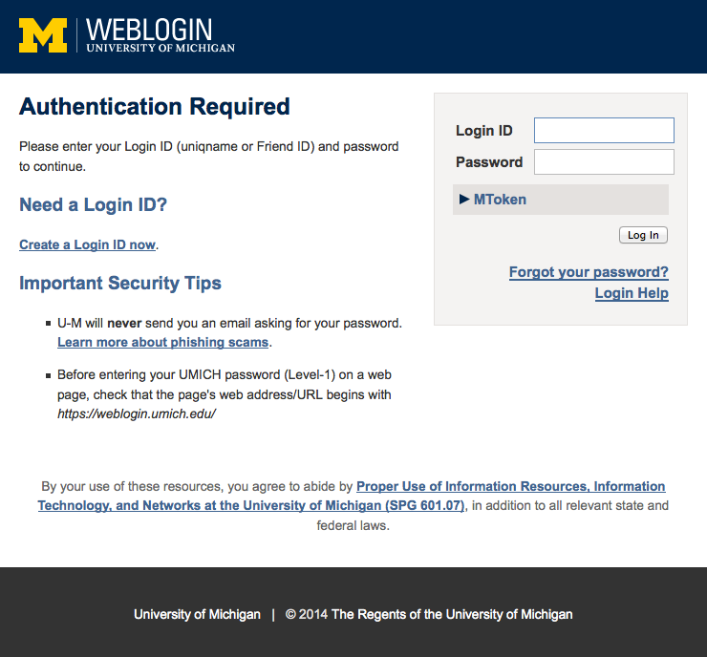

Slide 10
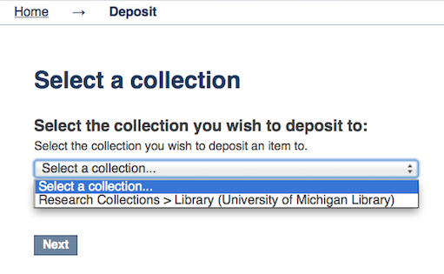

Slide 11
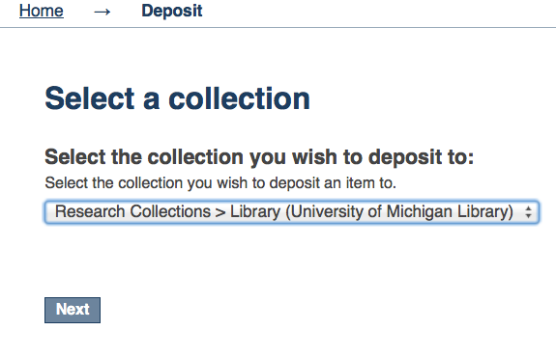

Slide 12
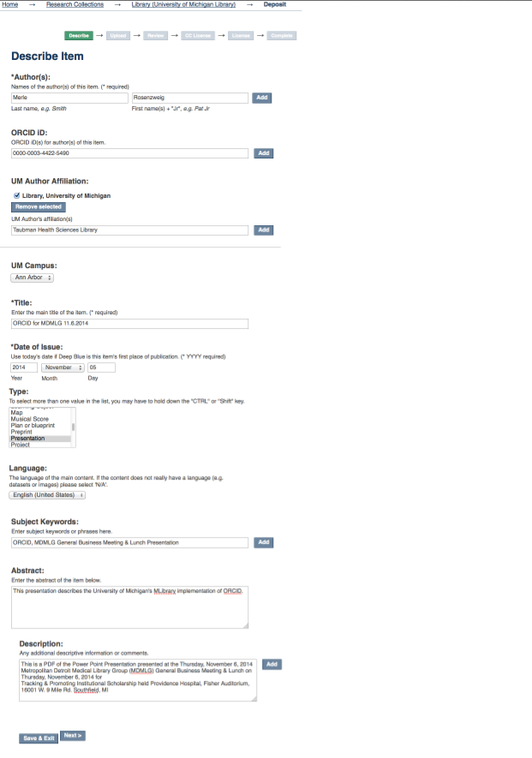

Slide 13
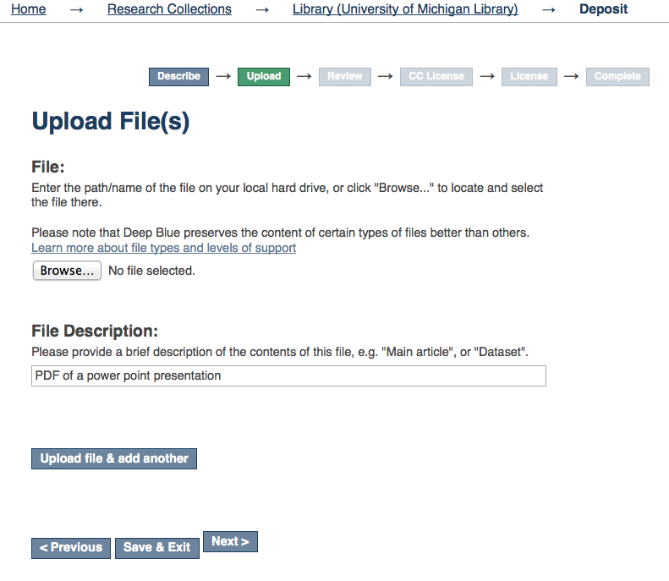

Slide 14
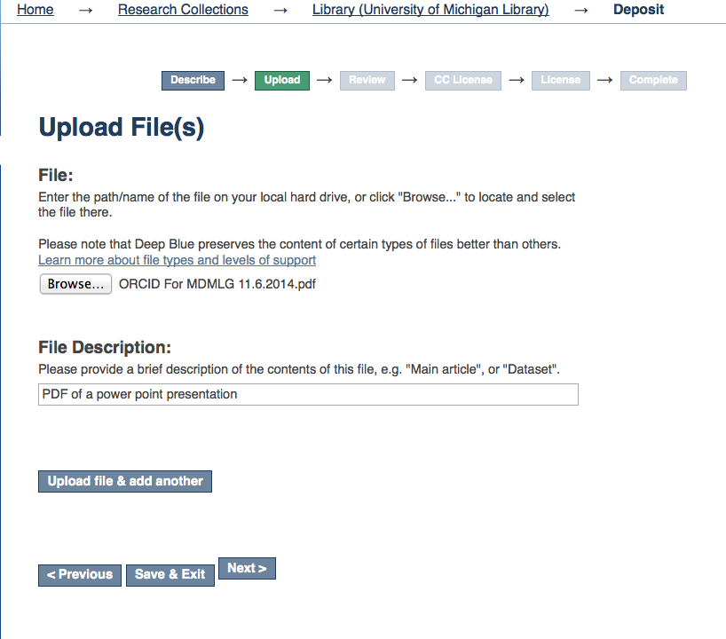

Slide 15
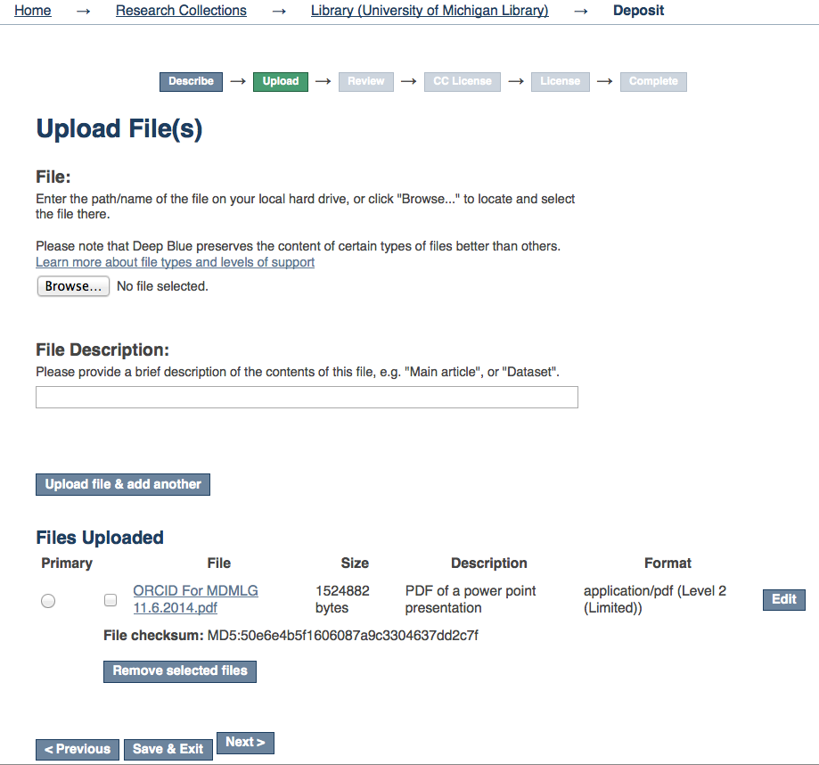

Slide 16
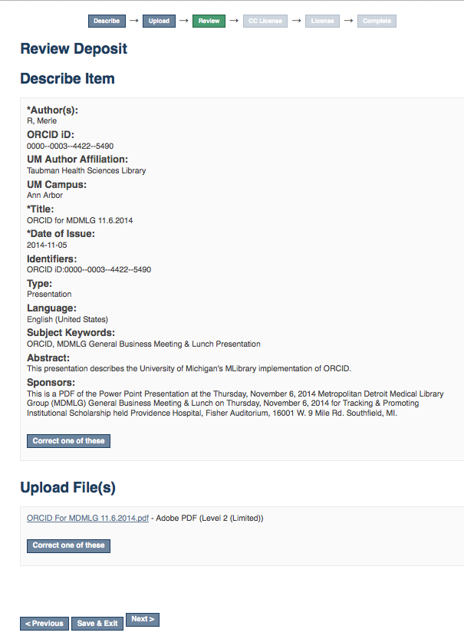

Slide 17
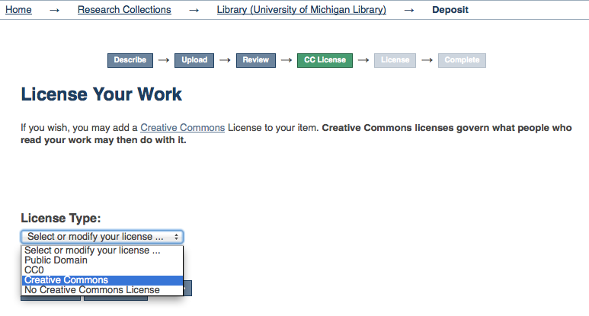

Slide 18
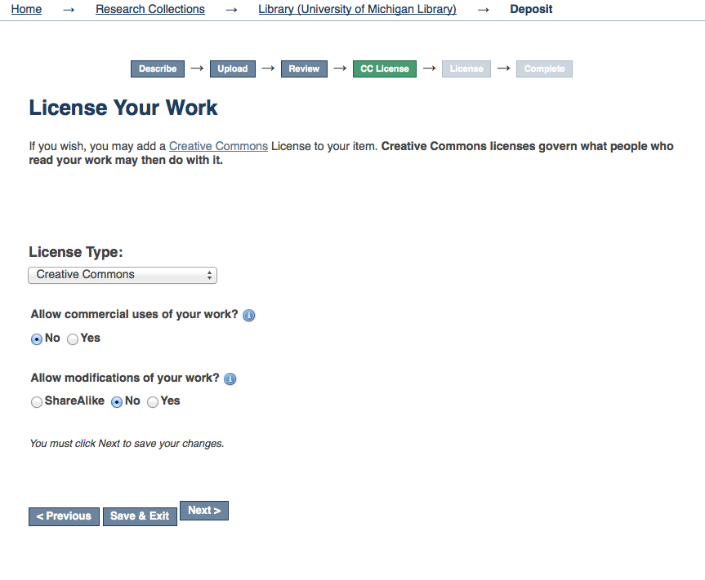

Slide 19
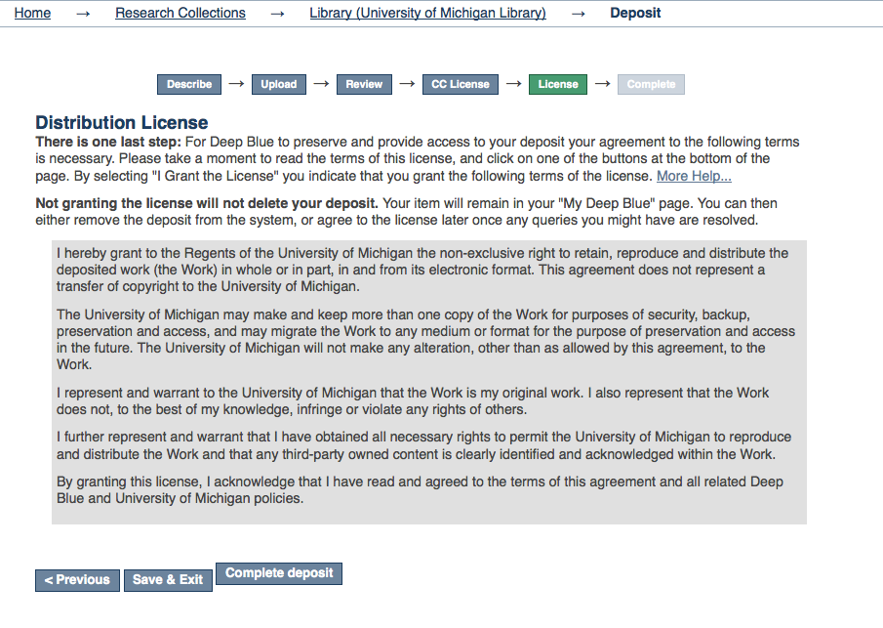

Slide 21
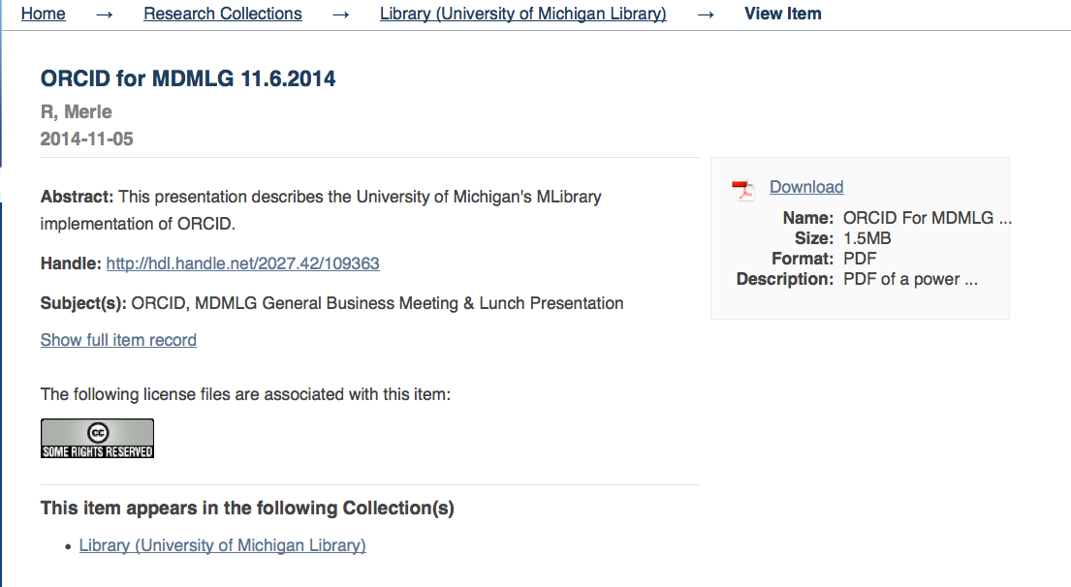

Slide 22
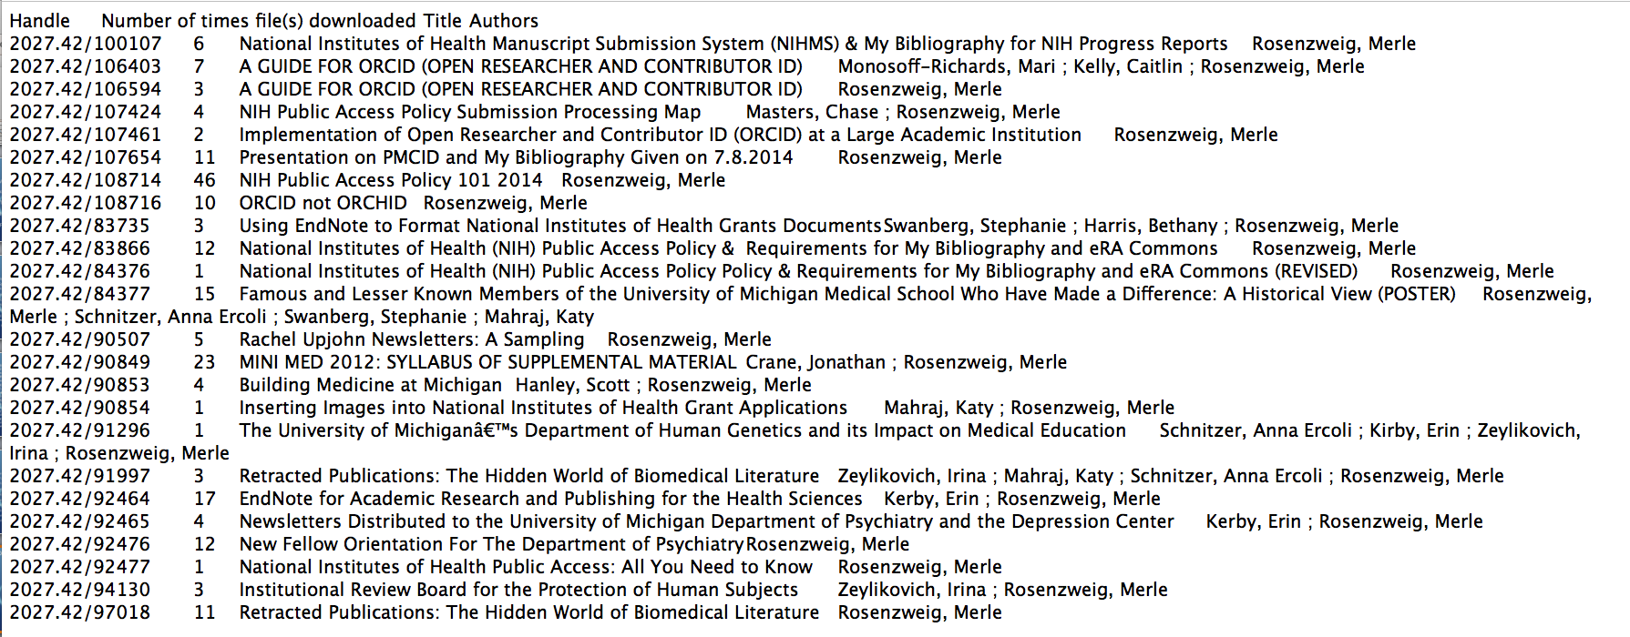
October 2014 download report from Deep Blue

Slide 24
Merle Rosenzweig
Taubman Health Sciences Library
oriley@umich.edu
http://orcid.org/0000-0003-4422-5490

