Slide 1
ORCID @ the
University of Michigan
Merle Rosenzweig
Taubman Health Sciences Library
ORCID:http://orcid.org/0000-0003-4422-5490

Slide 2
Open Researcher and Contributor ID (ORCID)
Among the thousands of authors publishing all over the world, some have distinctive surnames; some publish under multiple names—J.A.S. Sørensen, J.Aa. S. Sørensen, J.Åge S. Sørensen, J. Aage S. Sørensen, J. Åge Smærup Sørensen or J. Aage Smaerup Sørensen.
A researcher’s name is insufficient to reliably identify the author of, or contributor to, an article published in a journal or in a dataset uploaded to a repository.
The ORCID initiative was launched on October 16, 2012 with the aim of solving the name ambiguity problem in publishing.
ORCID is an open, non-profit initiative and registering is “free”.

Slide 3
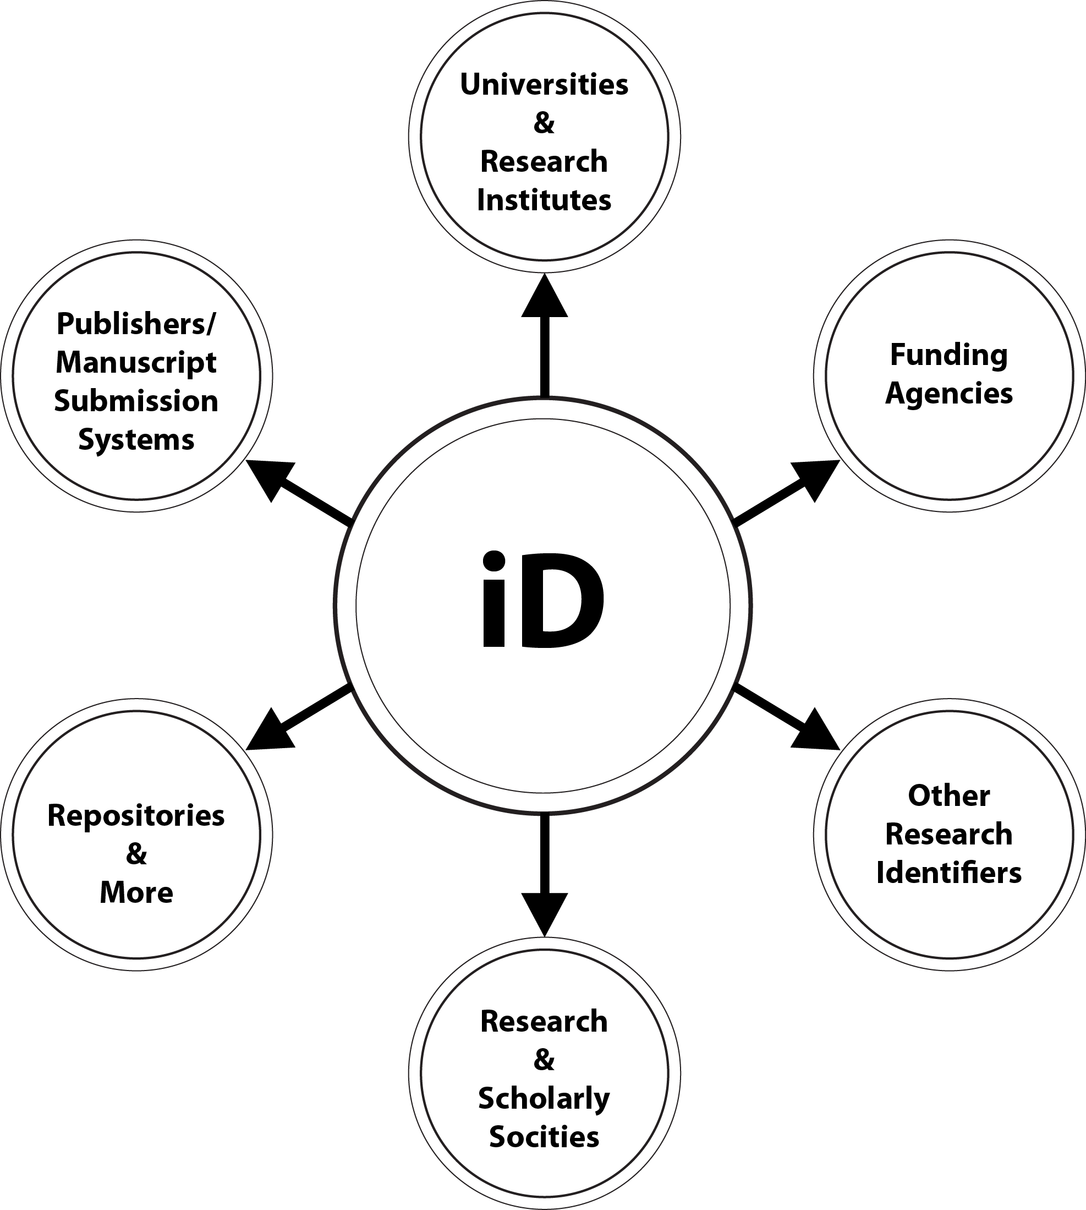
ORCID is a hub connecting the research landscape.

Slide 4
ORCID TASK FORCE
Steps for Implementation

Slide 5
Implementation
In December, 2012, MLibrary signed a Member License Agreement with ORCID which allows us to:
create ORCID records,
deposit to existing ORCID records, and
use various APIs and the data those APIs can access to perform tasks associated with ORCIDs.

Slide 6
Assigning ORCIDs
Allow the University to obtain existing ORCIDs for faculty who have associated the ORCID with a umich.edu email address.
Allow the University to assign new ORCIDs for all faculty and staff at the University of Michigan who publish either by (1) manual entry or (2) batch mode.

Slide 7
ORCIDs Assigned To
All librarians ~ 125
All faculty in the University of Michigan Department of Human Genetics
All faculty in the University of Michigan Department of Computational Medicine and Bioinformatics
All faculty in the University of Michigan Department of Molecular & Integrative Physiology

Slide 8
Incorporate ORCID
into UM Online Systems

Slide 9
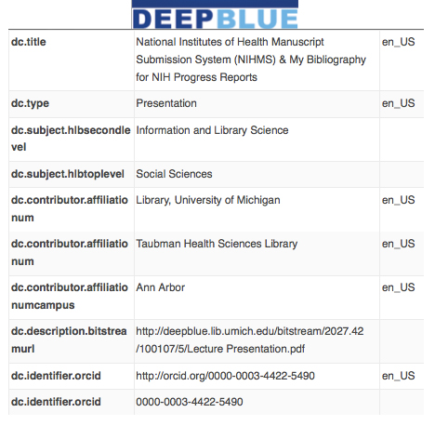

Slide 10
A directory of people & groups at UM
The MCommunity Directory contains profiles for all current members of the university community—students, faculty, staff, alumni, and sponsored affiliates—on all three campuses (Ann Arbor, Dearborn, and Flint).
By incorporating ORCIDs into and traveling along with MCommunity records our researchers need only remember their uniqname.

Slide 11
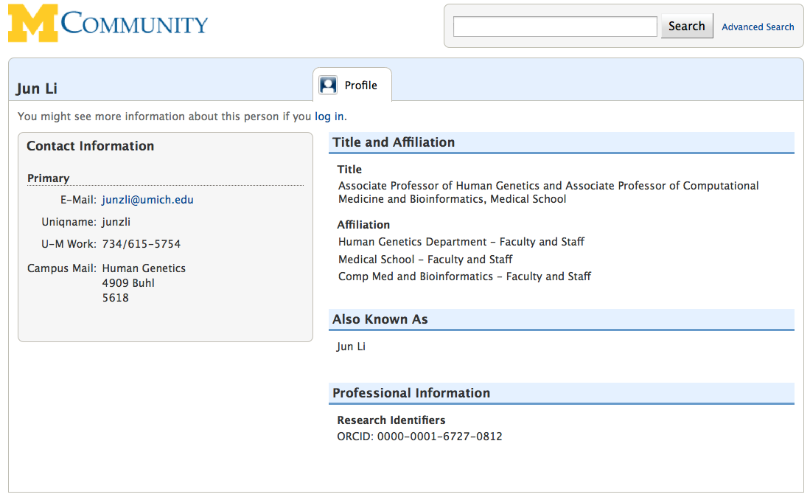

Slide 12
Incorporating ORCIDs into M-CV
M-CV is the Medical School Faculty Curriculum Vitae online system.
All UM Medical School faculty must have an M-CV.

Slide 13
Incorporating ORCIDs into Michigan Experts
A searchable database of research expertise across disciplines from several schools/colleges or institutes at the University of Michigan.

Slide 14
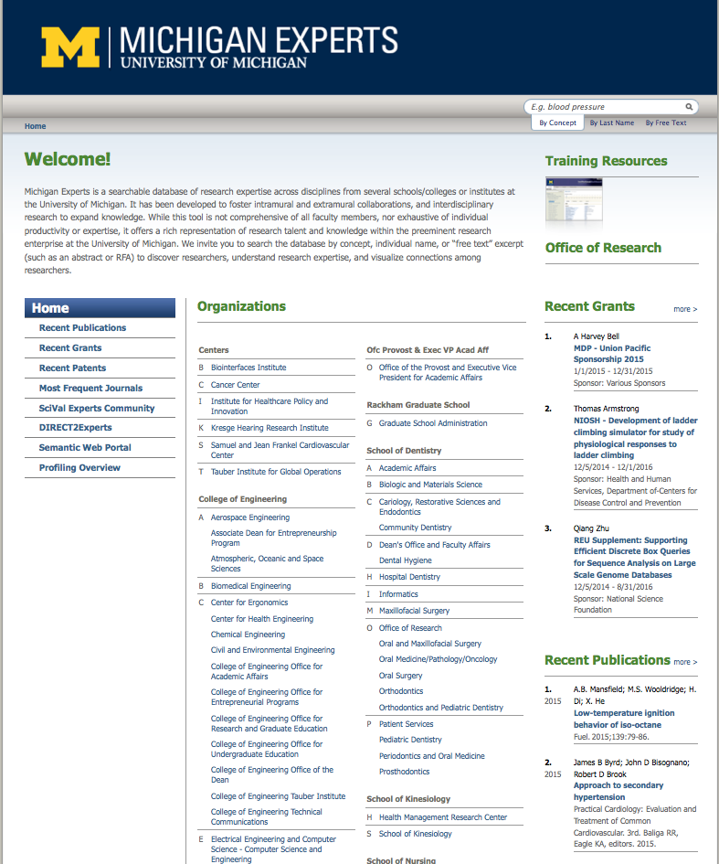

Slide 15
Next Steps
Build a web application for researchers to self-report their current iDs or to self-provision or “mint” new ORCID iDs.
Onboarding/auto provisioning of ORCID iDs for future employees and potentially doctoral students.
Continued outreach to professional schools and departments.
Finalizing the new Committee on Institutional Cooperation (CIC) consortial contract with ORCID.

Slide 16
Merle Rosenzweig
Taubman Health Sciences Library
oriley@umich.edu
http://orcid.org/0000-0003-4422-5490

