Slide 1
Sladen Library
Henry Ford Health System
Institutional Publications List
Angela Sponer
Librarian
Henry Ford Health System
Sladen Library
asponer1@hfhs.org
November 6, 2014

Slide 2


Goals of Publications List
Capture any and all publications
  Journal Articles
  Book Chapters / Books
  Meeting Abstracts
  Poster Presentations
  Novels, memoirs, etc…
2. Distribute list
Email
Print
Sladen Library Website
Notes:
Each month a list is created, last year just over 1300 citations

Slide 3

Capturing Publications
Automatic searches in PubMed, Web of Science
Searches also done in Scopus and CINAHL
Manual searching Google Scholar
Request for citation information from the authors themselves
Flying Books by Ruskin the Pea @ deviantart.com
Notes:
6 month scoop

Slide 4

My NCBI Saved Search:
hfh[ad] OR
hfhs[ad] OR
(henry[ad] AND ford[ad]) OR “henry ford”

Slide 5

Web of Science Weekly Alert
AD=henry ford
OR AD=hfhs
OR AD=hfh

Slide 6
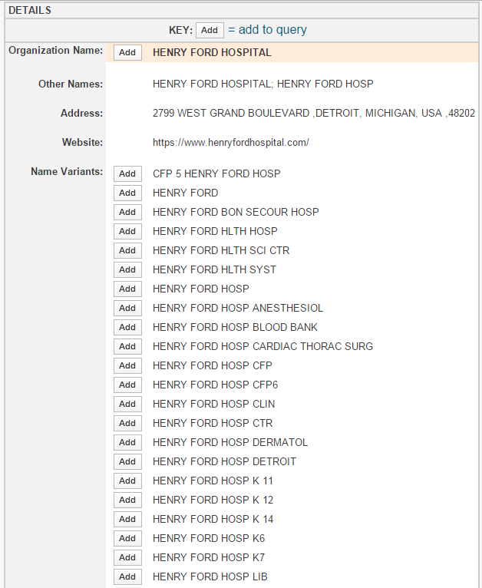
Web of Science
Organization-Enhanced Searching
40+ Name Variants have been found for Henry Ford Hospital

Slide 7
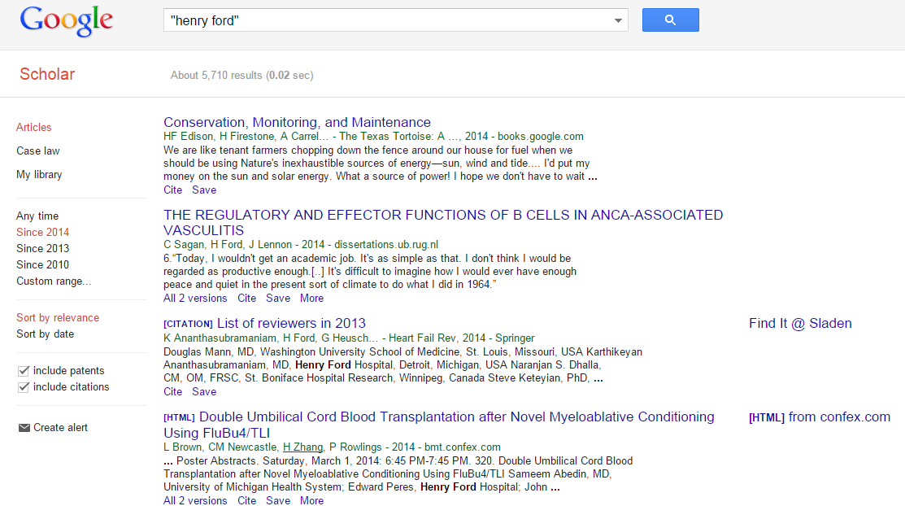
Google Scholar
Limit to current year
Hand search

Slide 8
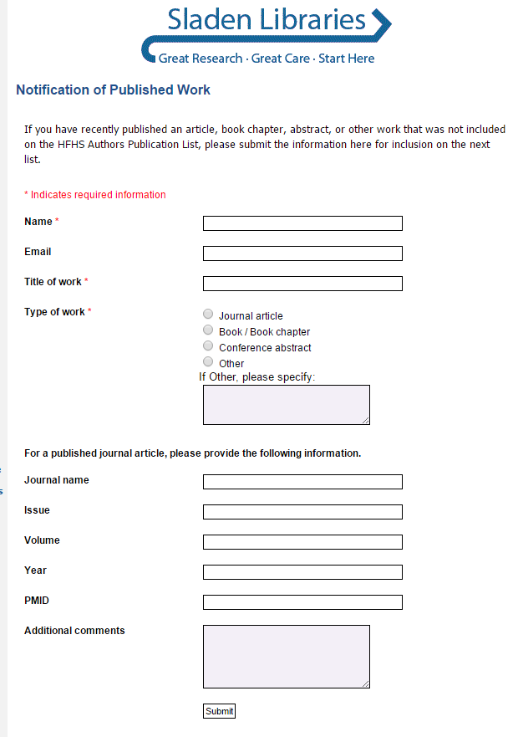
Notification of Published Work Online Form

Slide 9

EndNote
Store citations throughout the month
Customized Output Style to display author’s department and PMID (when applicable)
Notes:
JAMA

Slide 10
Citation Example
Cardiology / Cardiovascular Research
Lee MS, Yang T, Adams GL, Mustapha J, and Das T. Pooled analysis of the CONFIRM Registries: outcomes in renal disease patients treated for peripheral arterial disease using orbital atherectomy J Invasive Cardiol 2014; 26(8):350-354. PMID: 25091092. Full Text
Notes:
Department heading, author names bolded, PMID, link to the full text, affiliation as listed in journal

Slide 11
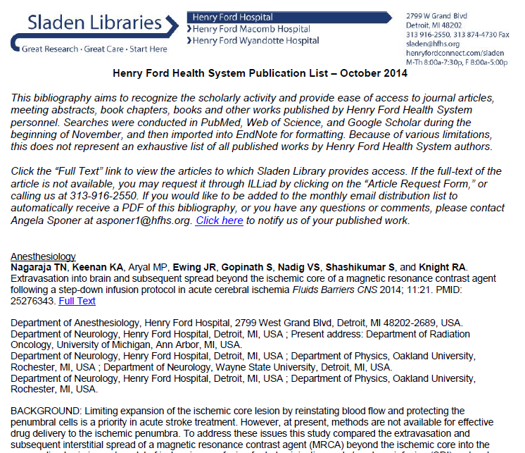
Monthly List
Notes:
First page Sladen Library letterhead, disclaimer, affiliations, abstracts

Slide 12
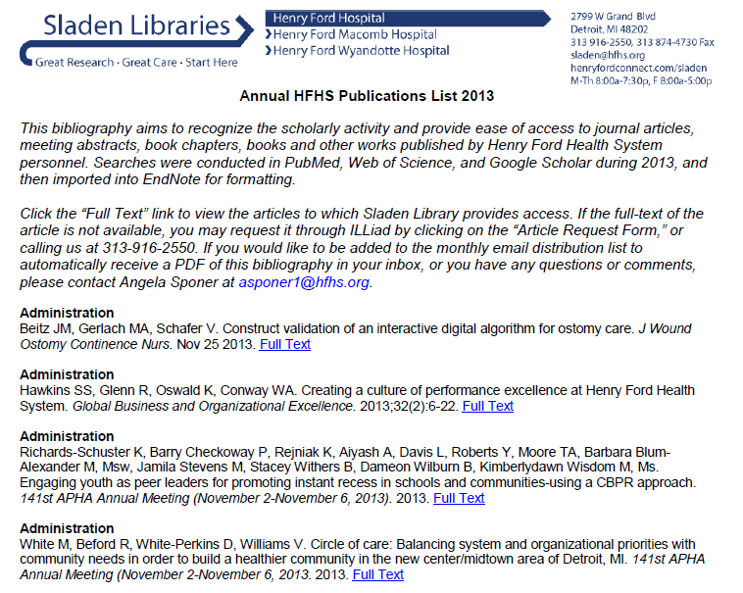
Annual List
Notes:
Article abstracts are not printed

Slide 13
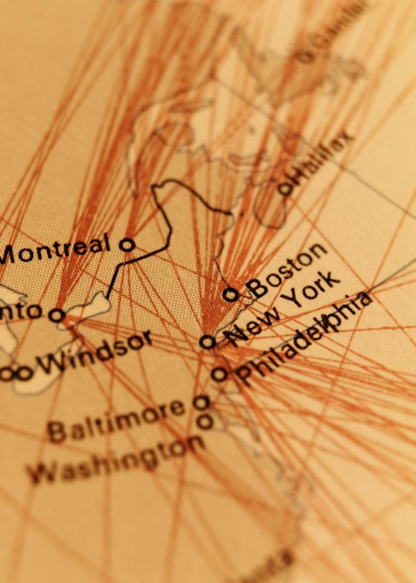
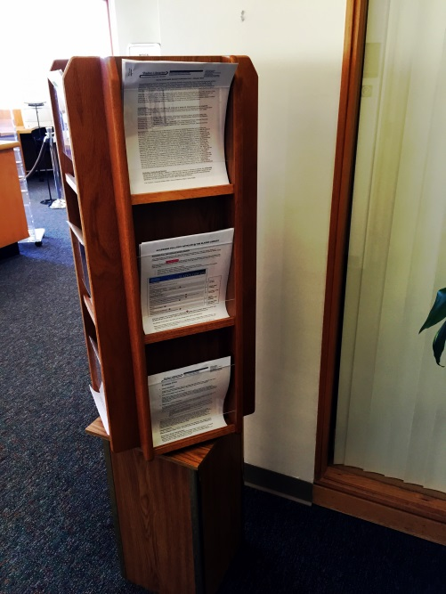
Distribution of List
Email
Print available at Sladen Library
PDF’s from 2006-present on Sladen website
Notes:
Over 250 people on email distribution, residents – become acquainted with other authors/researchers in institution, physicians, Media Relations, program coordinators. Reach out to authors not on distribution list

Slide 14
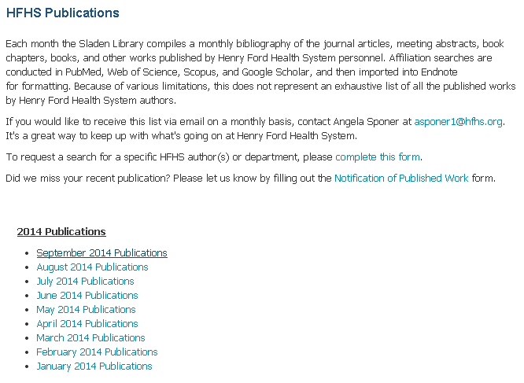
Lists on Sladen Website

Slide 15
Other Uses of the List
Department of Surgery – Online Portfolios
Research Administration Annual List
Author and Paper count by Research Administration
Notes:
EndNote file to people who created program for Department of Surgery, program to view

Slide 16
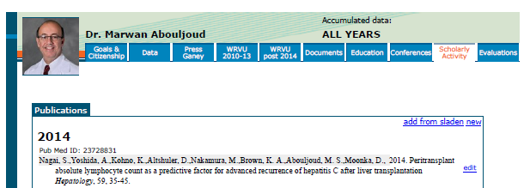
“ESR” Department of Surgery
Online Portfolio
Notes:
Ability to choose one’s own publications from Sladen. Education, Services, Resources

Slide 17
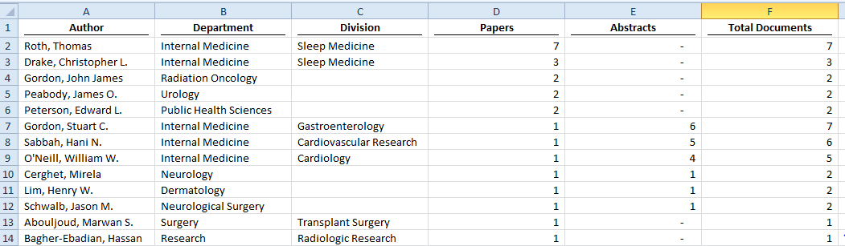
Research Administration
List of author names by number of citations
Notes:
3 files created from Excel – List of authors by number of citations, detailed list of each individual author’s information plus their citations, variations of author’s name

Slide 18
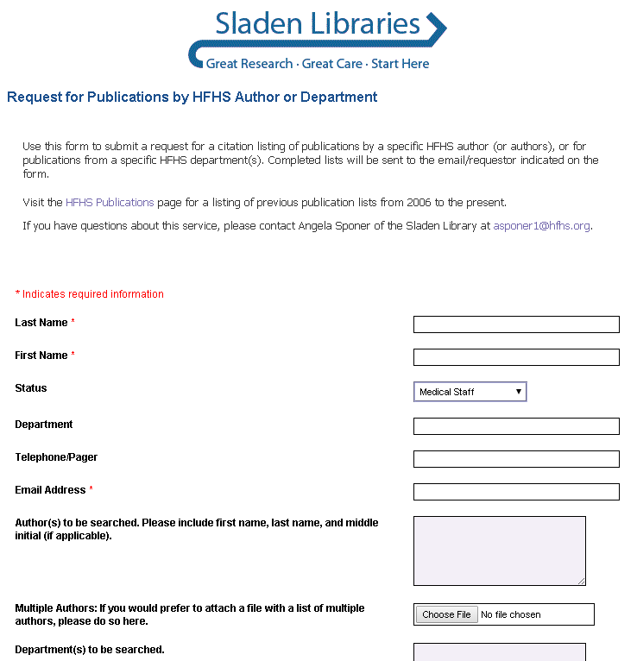
Publication Search Requests
Any HFHS employee may make a request
Turnaround is about 1 week
Notes:
Names and time frame is the most important information, also Department, citation style, PMID’s, EndNote library
Program coordinators, physicians, marketing materials, recent request from Director of Brand Management and Marketing

Slide 19
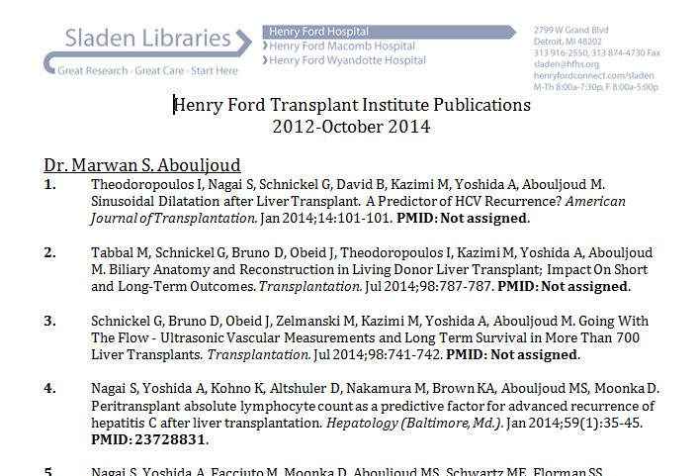
List Created for
HFHS Transplant Institute

Slide 20
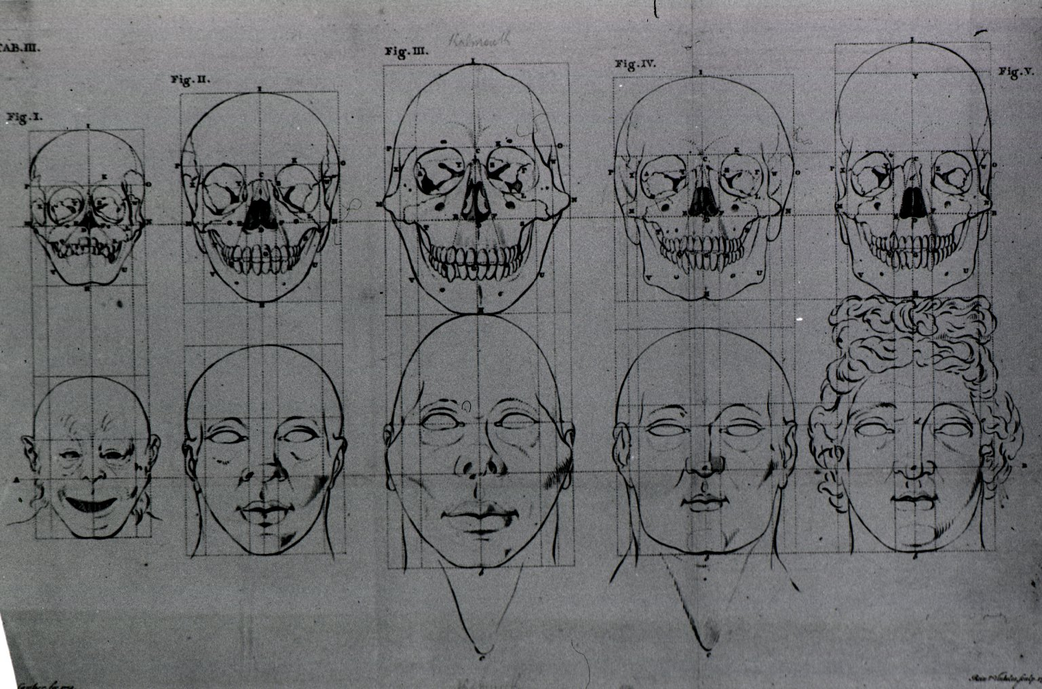
Process is ever changing to
fit the needs of the institution
Image from National Library of Medicine [Evolution of the head and skull] Camper fec. 1772.

