Slide 1
Reference Management Software Panel: RefWorks
Stephanie Swanberg, MSI, AHIP
swanberg@oakland.edu
Oakland University William Beaumont School of Medicine Library
MDMLG Meeting September 20, 2012

Slide 2
RefWorks
Subscription-based reference management software
Import, organize, generate, and format references in hundreds of citation styles
Share references with colleagues
Write-N-Cite, downloadable software that integrates with Microsoft Word to aid in formatting in-text citations and references within manuscripts

Slide 3
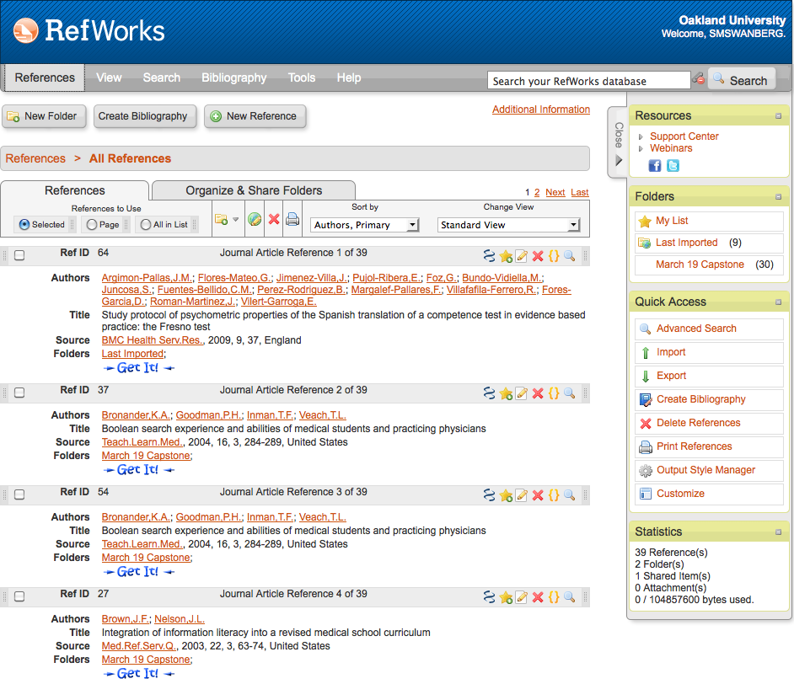
RefWorks Interface

Slide 4
Importing PubMed Citations into RefWorks
Method 1: Copy/Paste
Conduct your search in PubMed
Check the citations you wish to export to RefWorks
Go to Display Settings > select MEDLINE > click Apply
Select all > copy the entire selection
Open RefWorks in a separate window and login if necessary
Go to References > Import > From Text
Select NLM PubMed from the dropdown menu under Import Filter/Data Source
Paste your copied MEDLINE text into the textbox
If applicable, select or create a folder for your citations in Import into Folder
Click Import

Slide 5
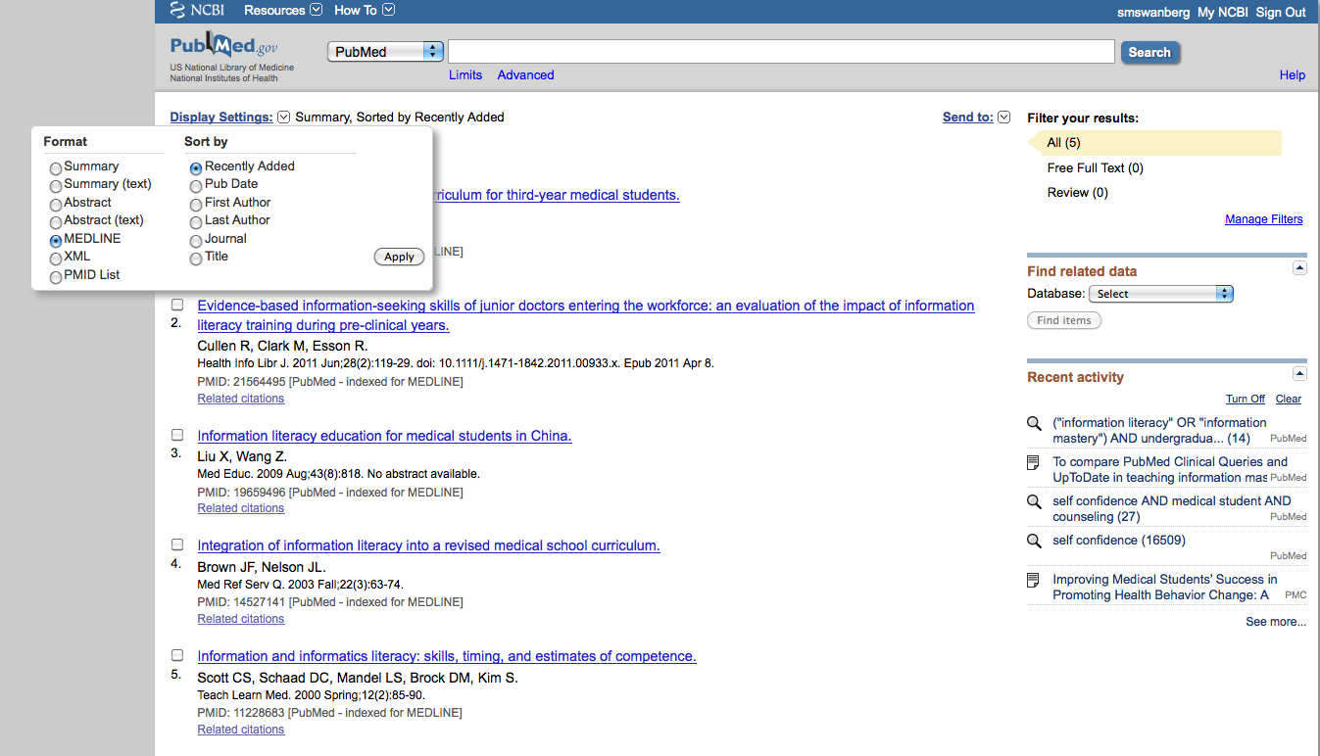
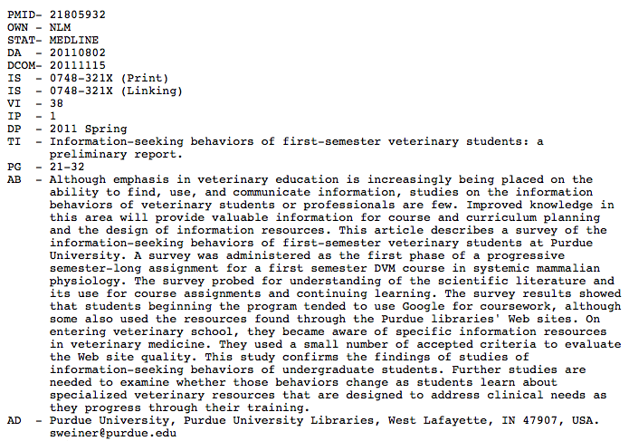

Slide 6
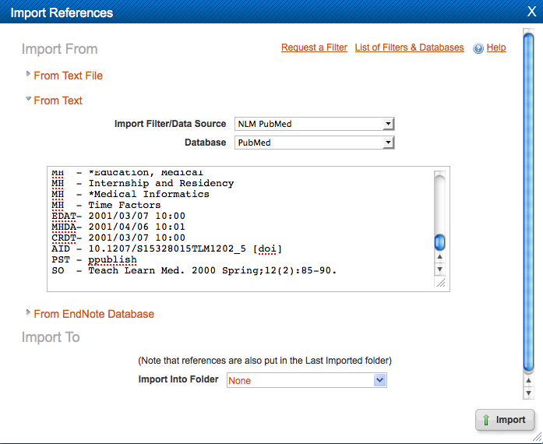
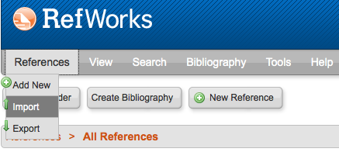

Slide 7
Importing PubMed Citations into RefWorks
Method 2: Save File
Conduct your search in PubMed
Check the citations you wish to export to RefWorks
Go to Send to > Citation Manager > Create File. This will create an .nbib file which is compatible with most online reference management software
Open RefWorks in a separate window and login if necessary
Go to References > Import > From Text File
Select NLM PubMed from the dropdown menu under Import Filter/Data Source and browse for your PubMed .nbib file under Select Text File
If applicable, select or create a folder for your citations in Import into Folder
Click Import

Slide 9
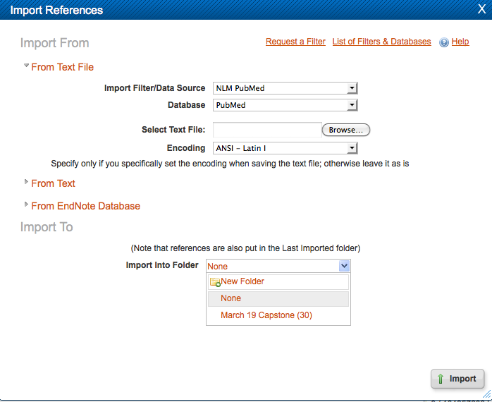

Slide 10
Sharing Citations with Colleagues
Go to the Organize and Share Folders tab
Find the folder of citations you wish to share > click the folder with the green arrow
You will be navigated to the Shared Folder Options page and provided with a URL or you may create an RSS Feed.
You can simply copy and paste this URL into an email and send it to your colleagues.
Critique: Feature is very limiting – only the person who created the folder and shared it can edit, add citations; it appears as read-only to all other collaborators

Slide 11
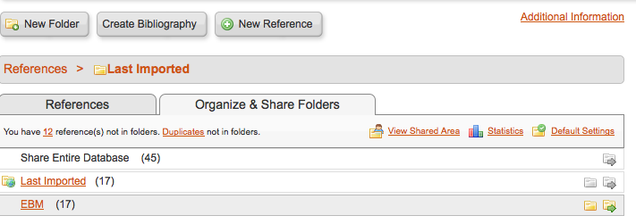
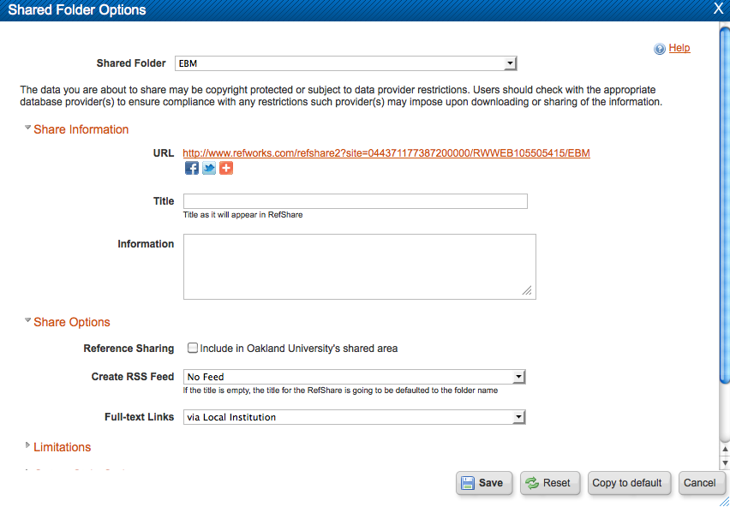

Slide 12
Searching an Online Catalog or Database in RefWorks
Go to Search
Select Online Catalog or Database
Select a resource to search
Critique: When searching PubMed, you have little control over your search and you lose the ability to apply limits and use MeSH terms

Slide 14
Creating Bibliographies & Inserting into Manuscripts
Choose your Output Style from the dropdown menu, such as AMA, NIH, or JAMA.
Expand the Format a Bibliography from a List of References heading
Choose the File Type you would like to create (Word for PC or MAC, HTML page, text file, or Open Office)
Choose the folder from which you wish to create your reference list in References to Include
Click Create Bibliography
A file will be generated and you may copy and paste all citations from this document into your manuscripts

Slide 15
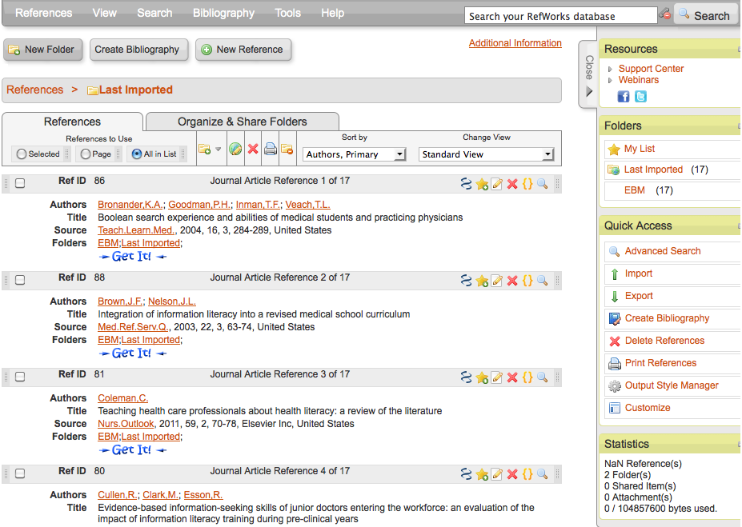

Slide 16
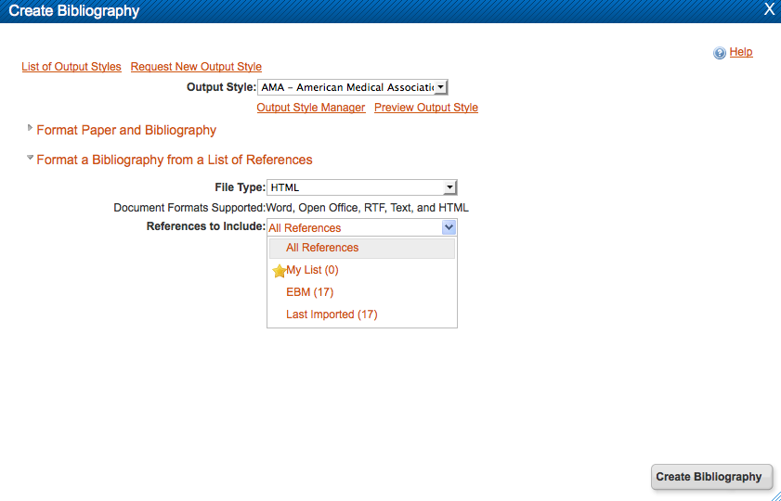

Slide 17
Write-N-Cite
Desktop software downloaded from the RefWorks online interface
Allows you to:
Insert citations from your RefWorks database into Word documents
Correctly format in-text citations and bibliographies in your preferred/required citation style

