Slide 1
Use of the Literature and Library Resources
Sarah Whitehouse
Medical Education and Internal Medicine
Henry Ford Hospital

Slide 2
Roles: Teach, Edit, Write
Medical Education
Medical students
Residents
Fellows
Program Directors
Department of Medicine
Staff physicians

Slide 3
Primary Questions
Manuscripts Received
Does the manuscript…
Follow the guidelines for type of study?
Include the most current literature?
Cite appropriate references from the journal selected for manuscript submission?
Meet the journal’s instructions?
IRB applications
Study question
Define gap in literature between what is known vs unknown
Manuscripts to Write
Literature search
Journal selection

Slide 4
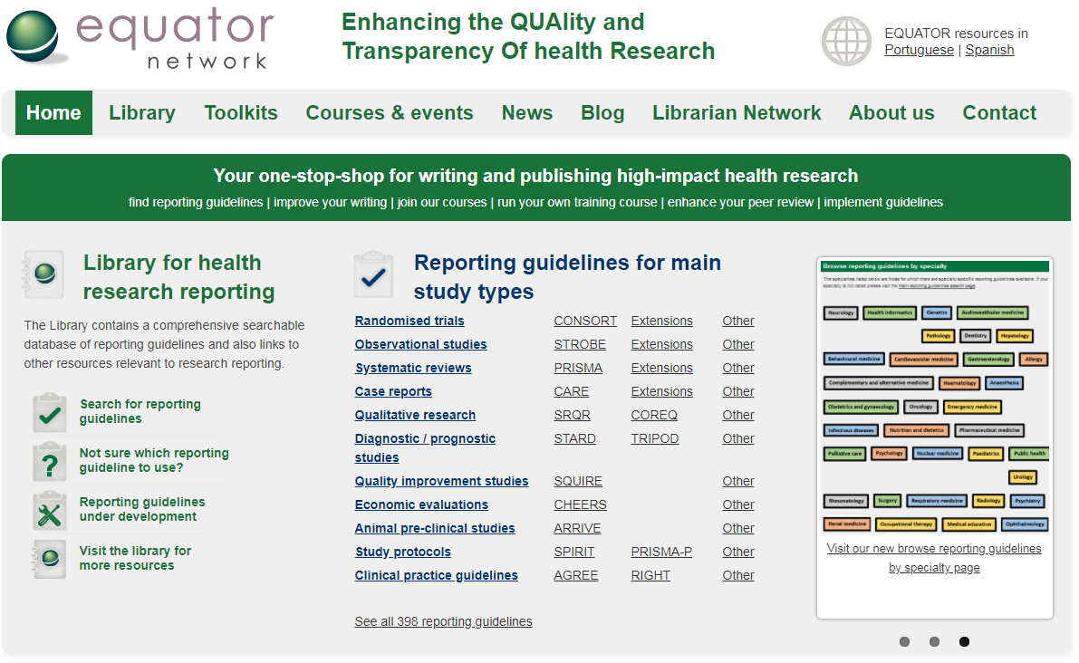
Guidelines for Type of Study: www.equator-network.org

Slide 5
Literature Search
Keywords
Disconnect between search terms and published articles
Evolution of concept over time can change keywords
Today “patient experience” vs prior “patient satisfaction”
Different terms for same subject during concept evolution
Physician burnout vs physician wellness vs physician wellbeing
Search Sites
PubMed
Journal website
Google Scholar
Journal/Author Name Estimator (JANE)

Slide 6
Finding keywords for “physician engagement” work engagement, engagement strategies, physician job satisfaction

Slide 7
PubMed
Keyword
Titles with your search term
Article match
Similar articles
Cited by
Best match vs Most Recent
References for this PMC article
Filter results
Systematic reviews
Publication by date

Slide 8
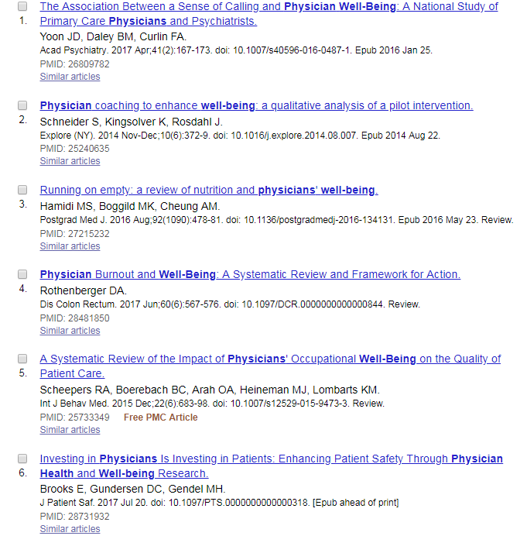
Literature Search for Physician Wellness Study
PUBMED: Physician Wellness Physician Wellbeing

Slide 9
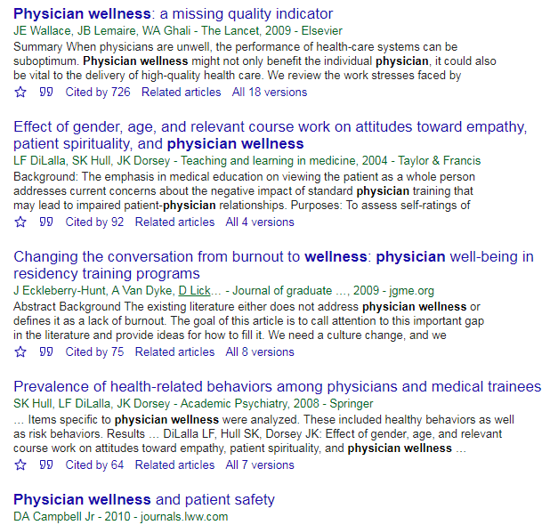
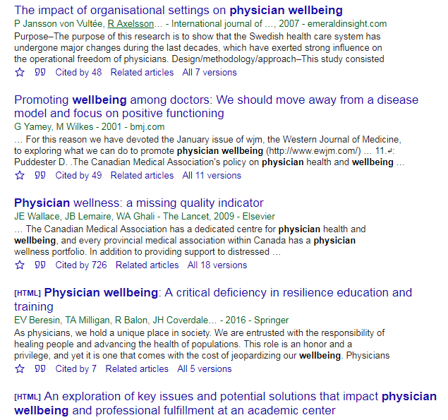
Google Scholar: Physician Wellness Physician Wellbeing

Slide 10
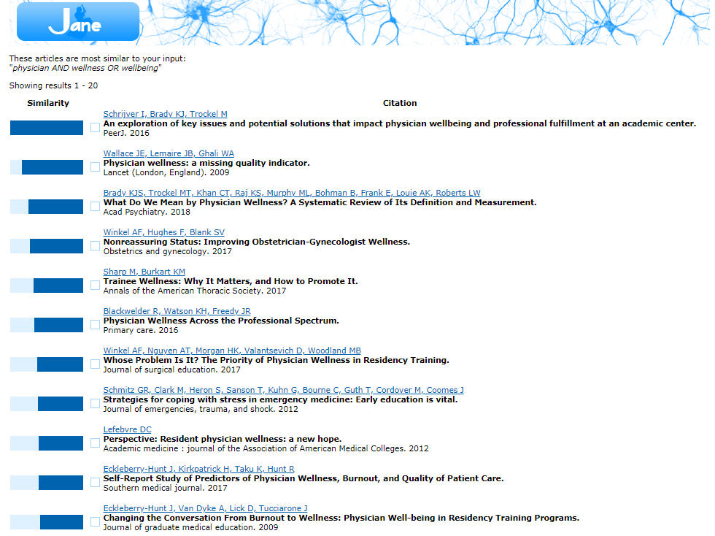
Journal/author name estimator: http://jane.biosemantics.org

Slide 11
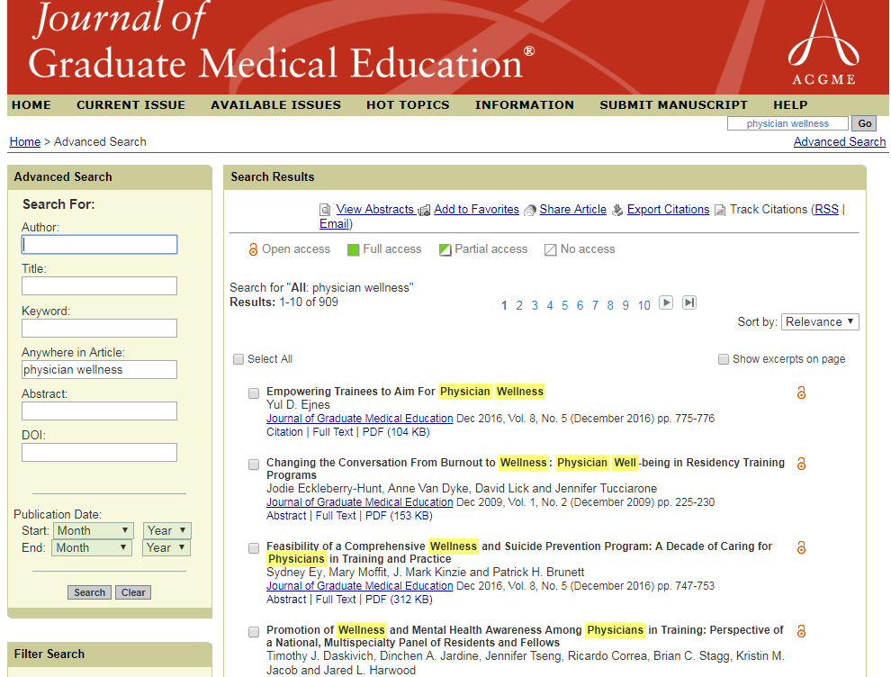
Search within journal database

Slide 12
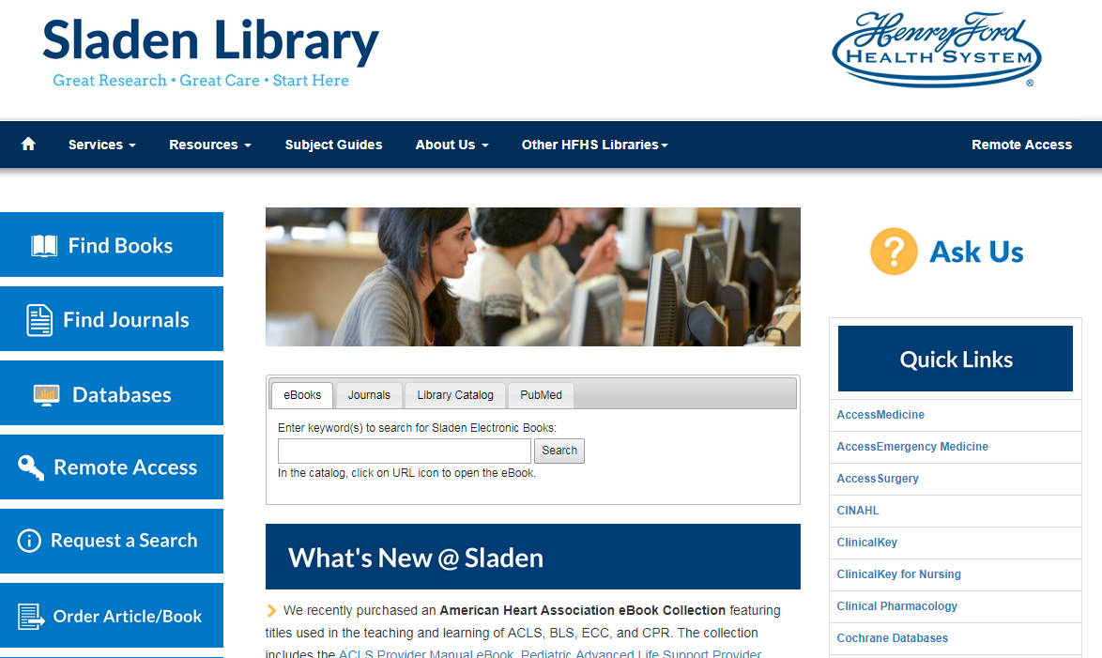

Slide 13
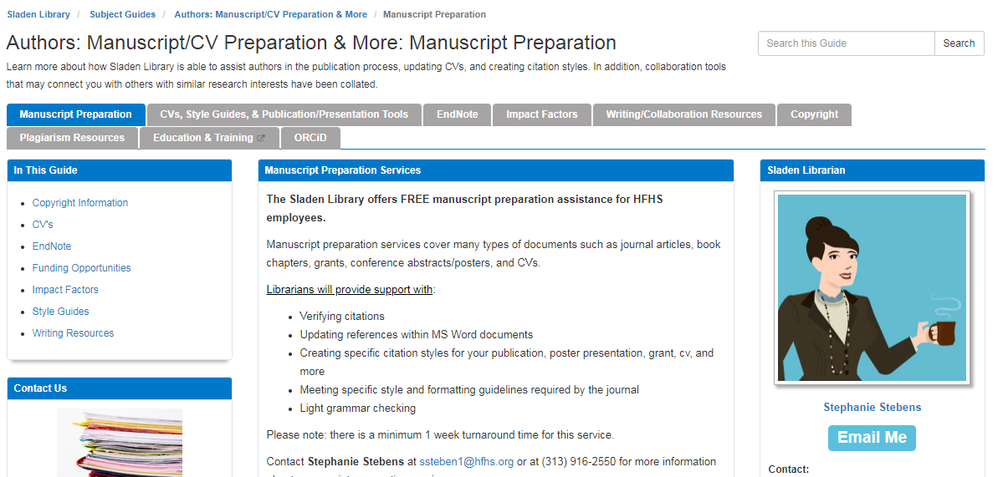

Slide 14
Sladen Library Resources
Literature search requests
Journal manuscript and reference formatting (Stephanie Stebens)
Training
Subject Guides
Open Access Publishing Questions
Any Question

